Slide 1
St. Louis Central Corridor West Building Permits
Monthly Report: October 2021

Slide 2
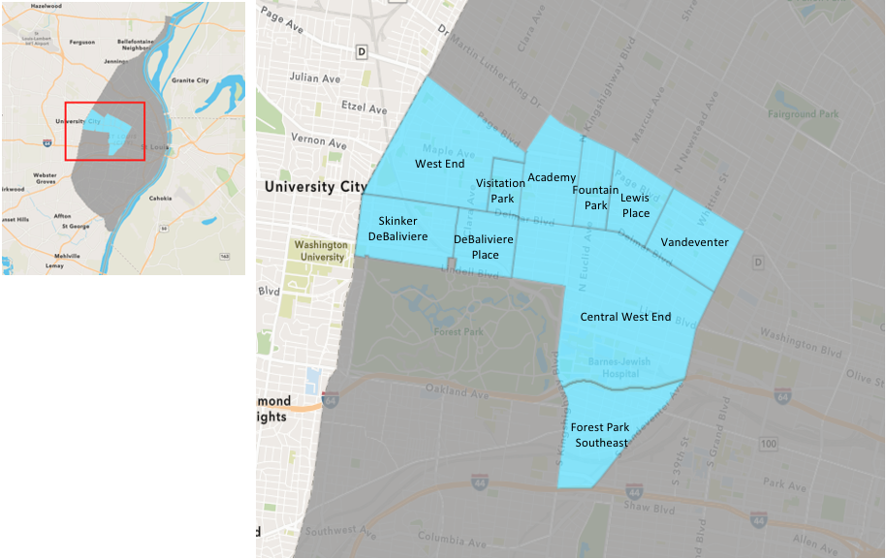
St. Louis Neighborhood Spatial Reference

Slide 3
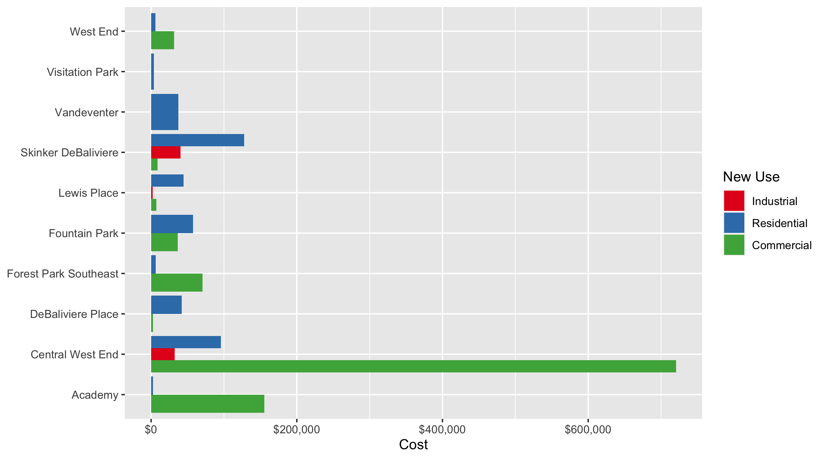
Neighborhood Summary: Average Building Permit Cost

Slide 4
Neighborhood Summary
October 2021 | October 2021 | October 2021 | October 2021
Neighborhood | Average Cost | # of Permits | Total Value of Permits
Academy | $117,125.00 | 4 | $468,500
Central West End | $333,356.46 | 41 | $13,667,615
DeBaliviere Place | $22,250.00 | 2 | $44,500
Forest Park Southeast | $22,317.08 | 12 | $267,805
Fountain Park | $47,000.00 | 4 | $188,000
Lewis Place | $24,166.67 | 6 | $145,000
Skinker DeBaliviere | $90,938.50 | 8 | $727,508
Vandeventer | $37,442.00 | 3 | $112,326
Visitation Park | $4,000.00 | 1 | $4,000
West End | $25,199.83 | 12 | $302,398
Last 6 Months | Last 6 Months | Last 6 Months | Last 6 Months
Neighborhood | Average Cost | # of Permits | Total Value of Permits
Academy | $47,320.60 | 25 | $1,183,015
Central West End | $1,129,696.18 | 255 | $288,072,526
DeBaliviere Place | $79,669.33 | 30 | $2,390,080
Forest Park Southeast | $167,599.45 | 107 | $17,933,141
Fountain Park | $277,293.29 | 14 | $3,882,106
Lewis Place | $85,279.94 | 16 | $1,364,479
Skinker DeBaliviere | $28,917.16 | 55 | $1,590,444
Vandeventer | $97,187.57 | 14 | $1,360,626
Visitation Park | $2,450.00 | 2 | $4,900
West End | $66,706.04 | 105 | $7,004,134

Slide 5
Core Neighborhoods

Slide 6
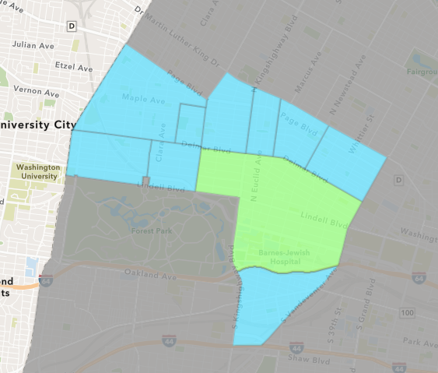
Central West End
October 2021 Neighborhood Cost Breakdown
Mean: $333,356
Median: $30,000
Range: $1,000 - $7,000,000

Slide 7
Central West End: Summary Notes
41 building permits in October 2021
13.89% change compared to October 2020 (36 total building permits)
$333,356: Average building permit cost in October 2021
44.36% change compared to October 2020 ($230,922)
358 total building permits in 2021
8.48% change YTD compared to this time in 2020 (330 total building permits)
$1,044,900: YTD average building permit cost in 2021
248.16% change YTD compared to this time in 2020 ($300,122)

Slide 8
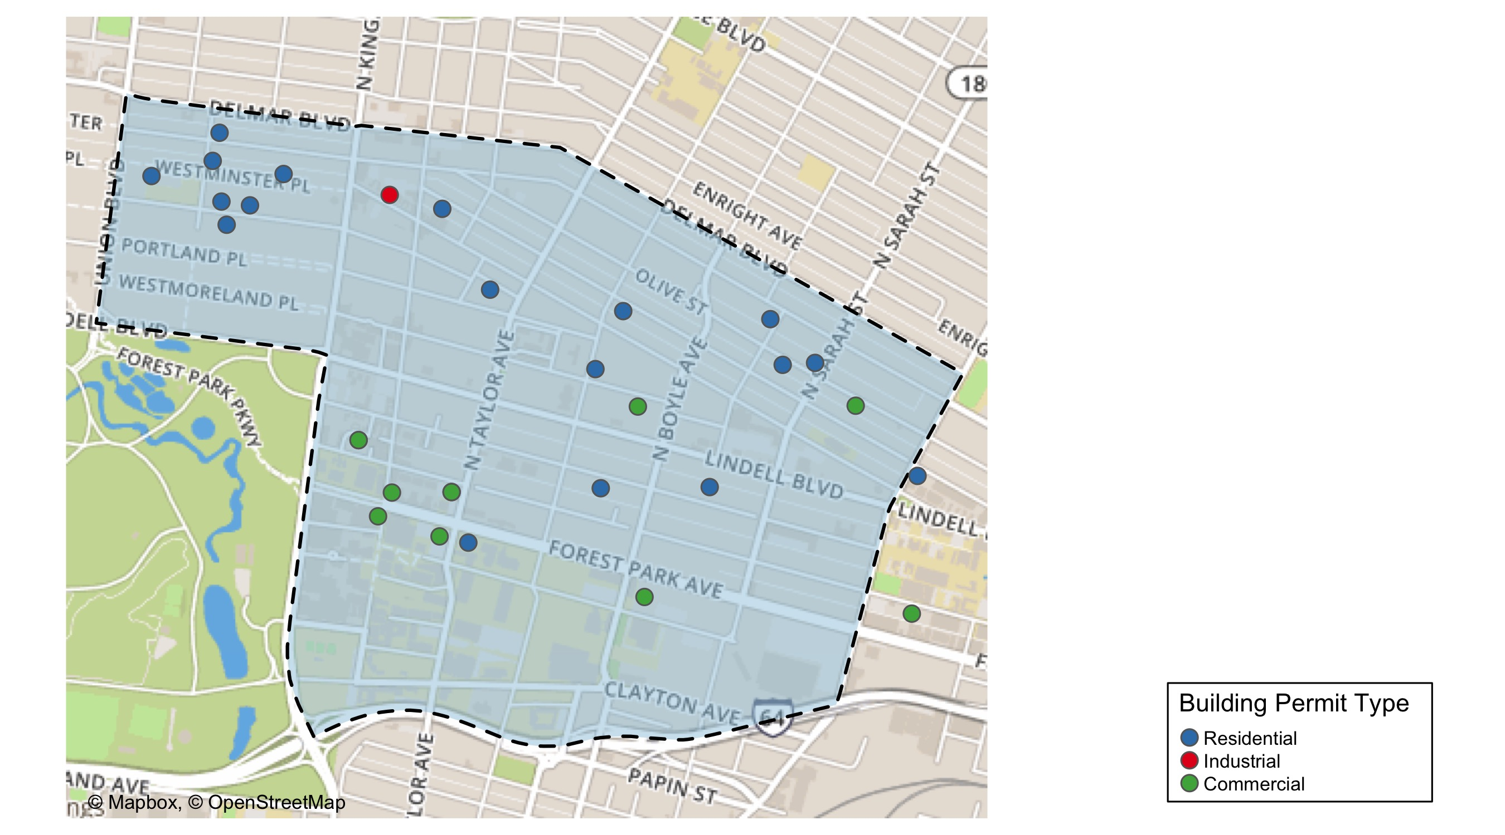
Central West End

Slide 9
Neighborhood Summary
October 2021 | October 2021 | October 2021 | October 2021
Permit Use | Average Cost | # of Permits | Total Value of Permits
Commercial | $720,542.25 | 16 | $11,528,676
Industrial | $32,300.00 | 4 | $129,200
Residential | $95,701.86 | 21 | $2,009,739
Last 6 Months | Last 6 Months | Last 6 Months | Last 6 Months
Permit Use | Average Cost | # of Permits | Total Value of Permits
Commercial | $2,778,675.71 | 89 | $247,302,138
Industrial | $1,927,376.59 | 17 | $32,765,402
Residential | $53,724.74 | 149 | $8,004,986

Slide 10
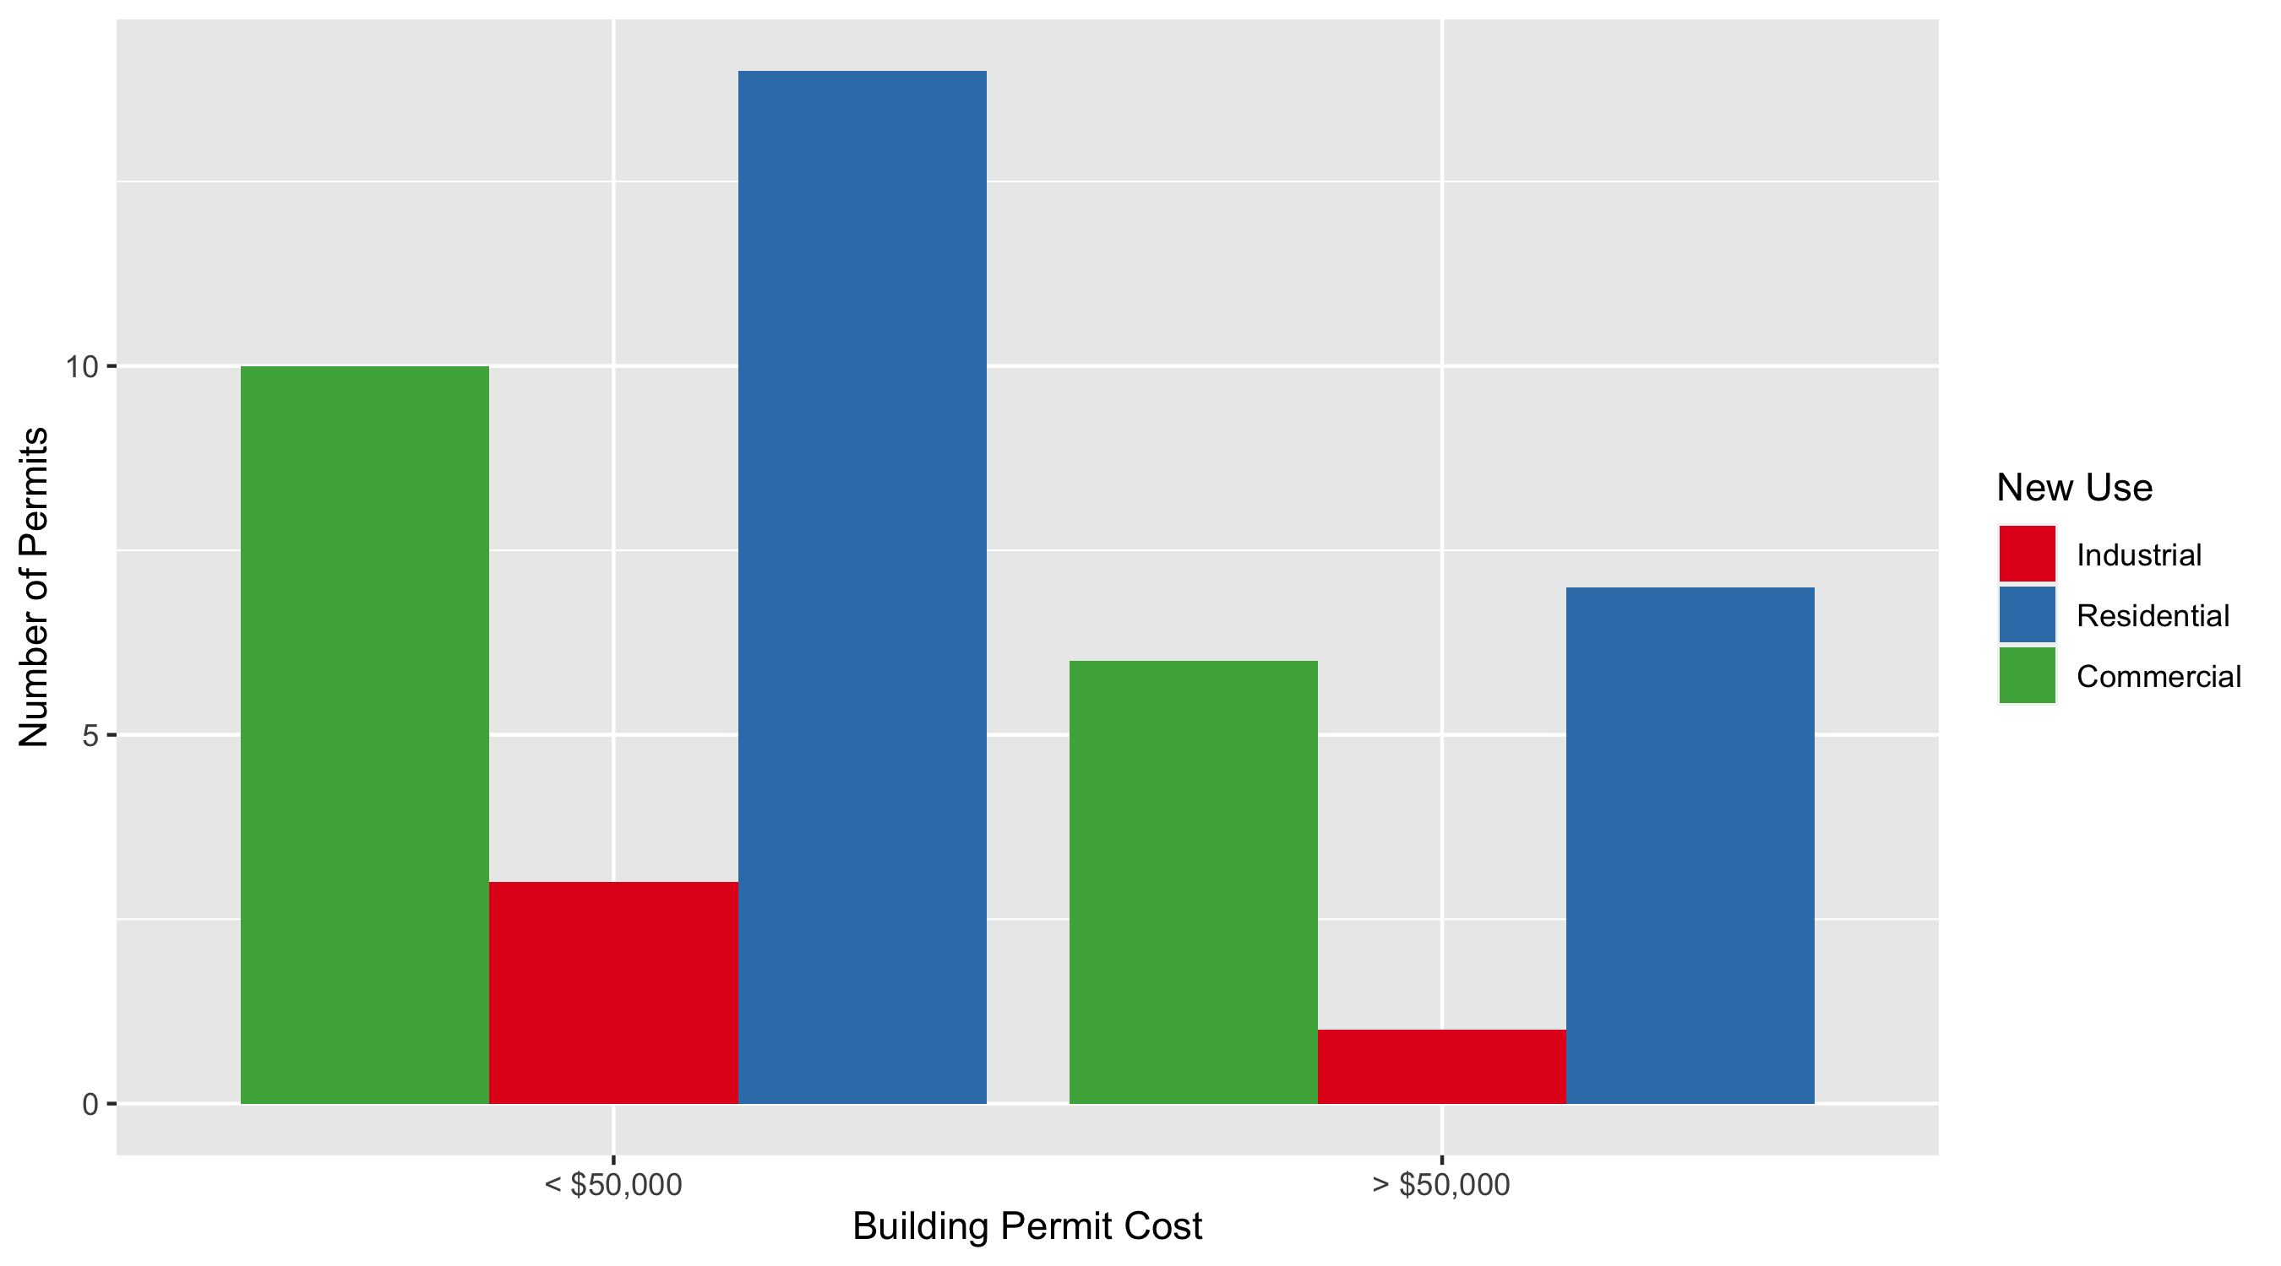
Central West End Permit Cost Breakdown

Slide 11
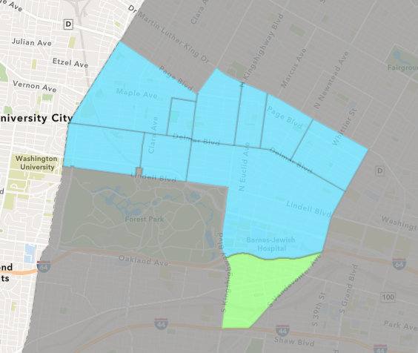
Forest Park Southeast
October 2021 Neighborhood Cost Breakdown
Mean: $22,317
Median: $3,250
Range: $105 - $200,000

Slide 12
Forest Park Southeast: Summary Notes
12 building permits in October 2021
-40.00% change compared to October 2020 (20 total building permits)
$22,317: Average building permit cost in October 2021
-79.57% change compared to October 2020 ($109,259)
148 total building permits in 2021
43.69% change YTD compared to this time in 2020 (103 total building permits)
$423,274: YTD average building permit cost in 2021
139.71% change YTD compared to this time in 2020 ($176,575)

Slide 13
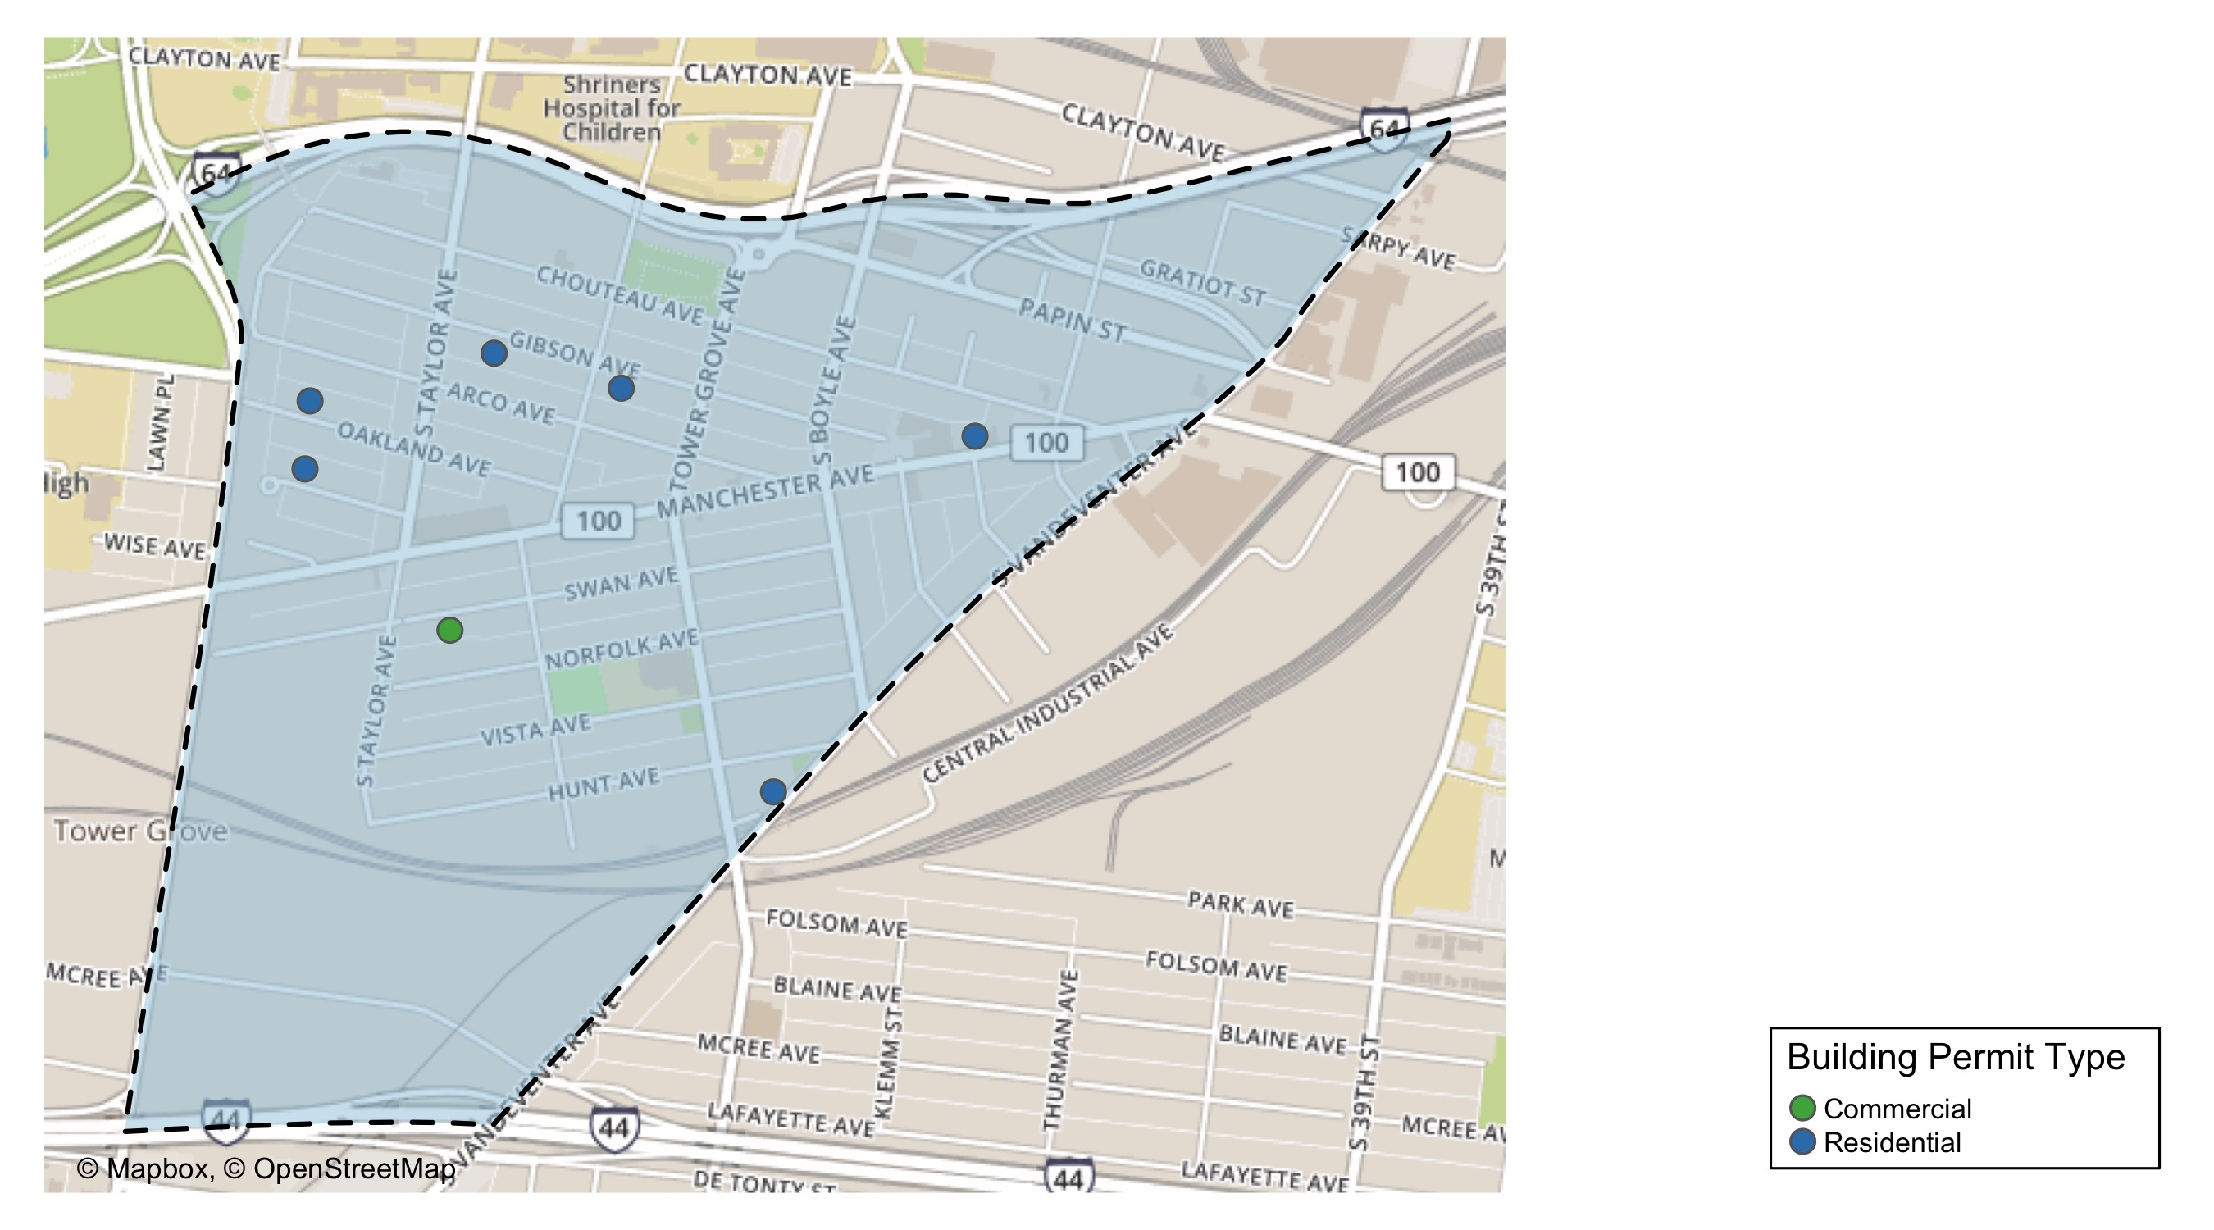
Forest Park Southeast

Slide 14
Neighborhood Summary
October 2021 | October 2021 | October 2021 | October 2021
Permit Use | Average Cost | # of Permits | Total Value of Permits
Commercial | $70,733.333 | 3 | $212,200
Industrial | $0.000 | 0 | $0
Residential | $6,178.333 | 9 | $55,605
Last 6 Months | Last 6 Months | Last 6 Months | Last 6 Months
Permit Use | Average Cost | # of Permits | Total Value of Permits
Commercial | $185,333.74 | 23 | $4,262,676
Industrial | $11,065.56 | 9 | $99,590
Residential | $180,945.00 | 75 | $13,570,875

Slide 15
Forest Park Southeast Individual Permit Breakdown
nbhd_name | Owner | New Use | Cost | address
Forest Park Southeast | CENCORE CAPITAL LLC | Residential | $2,700 | 4330 VISTA AV
Forest Park Southeast | WOODWARD LOFTS LLC | Commercial | $2,200 | 1519 TOWER GROVE AV
Forest Park Southeast | SWAN APARTMENTS LLC | Residential | $30,000 | 4500-40 SWAN AV
Forest Park Southeast | GATEWAY LOFTS LLC | Commercial | $200,000 | 4400 MANCHESTER AV
Forest Park Southeast | GREEN ST 4565 MCREE INVESTORS LLC AT | Commercial | $10,000 | 4565 MCREE AV
Forest Park Southeast | MCDERMOTT, BONNIE LOU | Residential | $3,500 | 4355 HUNT AV
Forest Park Southeast | DOLAN, CATHERINE E | Residential | $2,000 | 4448 ARCO AV
Forest Park Southeast | BEST, ANTHONY | Residential | $4,800 | 4216 GIBSON AV
Forest Park Southeast | CORNELL, LAWRENCE | Residential | $3,000 | 1117 TALMAGE AV
Forest Park Southeast | CORAZON INVESTMENTS LLC | Residential | $7,500 | 4311 ARCO AV
Forest Park Southeast | DAZ PROPERTIES LLC | Residential | $2,000 | 4567 ARCO AV
Forest Park Southeast | DAZ PROPERTIES LLC | Residential | $105 | 4565 OAKLAND AV

Slide 16
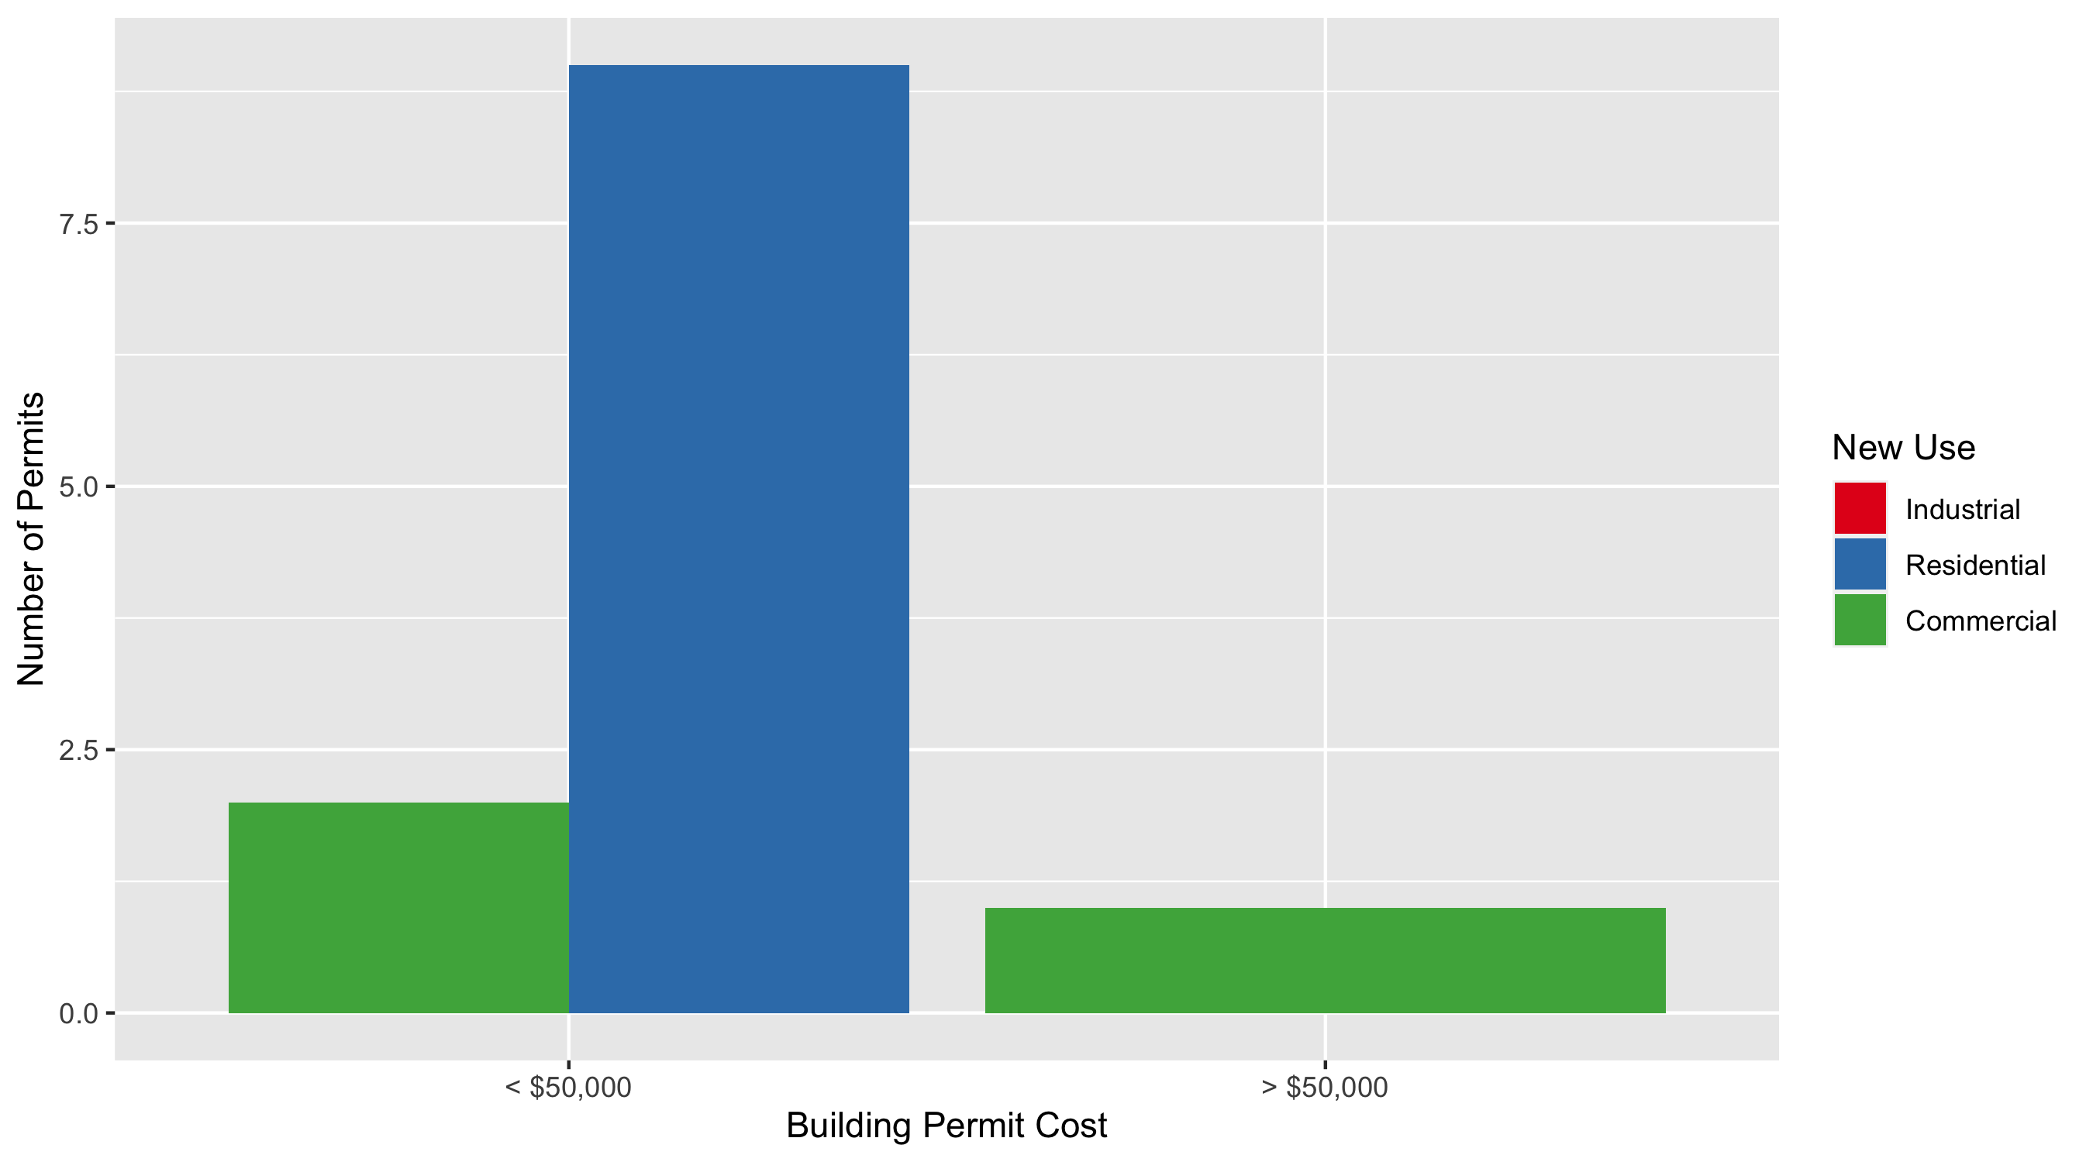
Forest Park Southeast Permit Cost Breakdown

Slide 17
Expanded Service Area

Slide 18
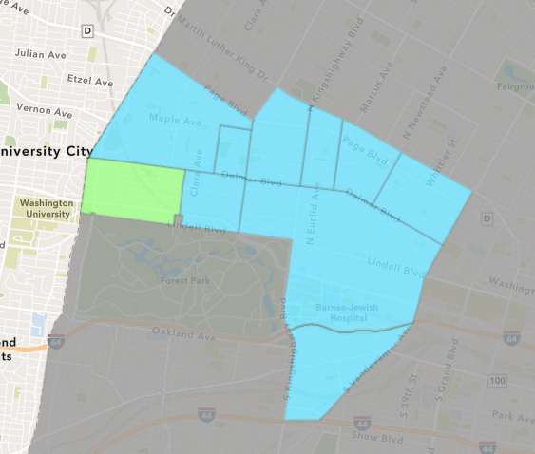
Skinker DeBaliviere
October 2021 Neighborhood Cost Breakdown
Mean: $90,938
Median: $23,500
Range: $3,202 - $500,000

Slide 19
Skinker DeBaliviere: Summary Notes
8 building permits in October 2021
-38.46% change compared to October 2020 (13 total building permits)
$90,938: Average building permit cost in October 2021
-25.98% change compared to October 2020 ($122,854)
77 total building permits in 2021
-25.24% change YTD compared to this time in 2020 (103 total building permits)
$32,502: YTD average building permit cost in 2021
-94.93% change YTD compared to this time in 2020 ($640,649)

Slide 20
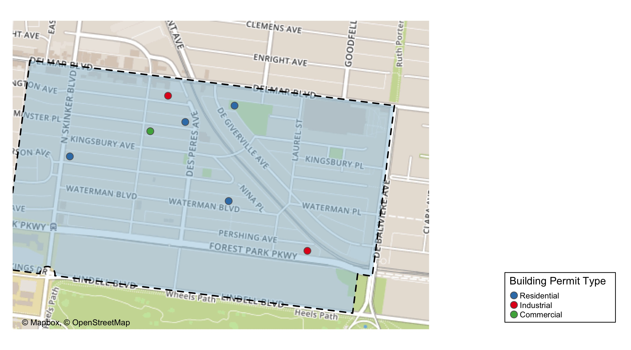
Skinker DeBaliviere

Slide 21
Neighborhood Summary
October 2021 | October 2021 | October 2021 | October 2021
Permit Use | Average Cost | # of Permits | Total Value of Permits
Commercial | $8,950.0 | 1 | $8,950
Industrial | $40,500.0 | 2 | $81,000
Residential | $127,511.6 | 5 | $637,558
Last 6 Months | Last 6 Months | Last 6 Months | Last 6 Months
Permit Use | Average Cost | # of Permits | Total Value of Permits
Commercial | $33,790.0 | 5 | $168,950
Industrial | $29,000.0 | 4 | $116,000
Residential | $28,380.3 | 46 | $1,305,494

Slide 22
Skinker DeBaliviere Individual Permit Breakdown
nbhd_name | Owner | New Use | Cost | address
Skinker DeBaliviere | BUILDER LLC | Residential | $500,000 | 5955 MCPHERSON AV
Skinker DeBaliviere | CHURCH BUILDING LLC | Commercial | $8,950 | 6166 DELMAR BLVD
Skinker DeBaliviere | HARRISON, TIMOTHY & MEGAN | Industrial | $45,000 | 5745 WATERMAN BLVD
Skinker DeBaliviere | SCHILLER, JEROME P & BRITT-MARIE TRS | Residential | $113,356 | 6150 MCPHERSON AV
Skinker DeBaliviere | BALESTRERI, ANTHONY & ERICA KAISER | Industrial | $36,000 | 6154 WASHINGTON AV
Skinker DeBaliviere | ANGELS ARMS | Residential | $11,000 | 5854 WATERMAN BLVD
Skinker DeBaliviere | SPMNECHO LLC | Residential | $10,000 | 6151 WESTMINSTER PL
Skinker DeBaliviere | GLORIA D DAVISON TRS | Residential | $3,202 | 5764 DEGIVERVILLE AV

Slide 23
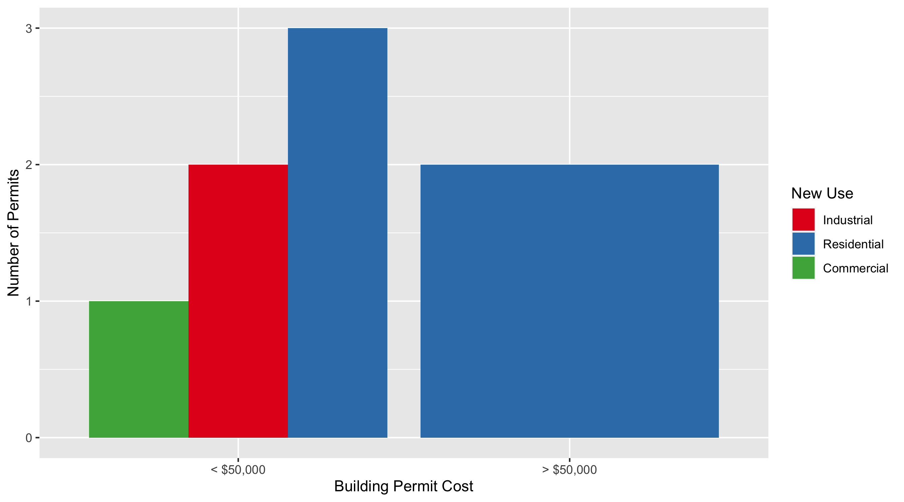
Skinker DeBaliviere Permit Cost Breakdown

Slide 24
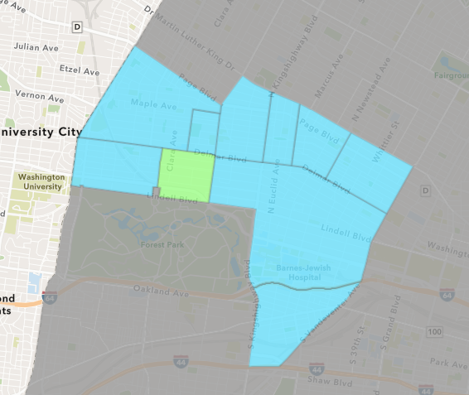
DeBaliviere Place
October 2021 Neighborhood Cost Breakdown
Mean: $22,250
Median: $22,250
Range: $2,500 - $42,000

Slide 25
DeBaliviere Place: Summary Notes
2 building permits in October 2021
-71.43% change compared to October 2020 (7 total building permits)
$22,250: Average building permit cost in October 2021
-62.28% change compared to October 2020 ($58,980)
45 total building permits in 2021
32.35% change YTD compared to this time in 2020 (34 total building permits)
$79,188: YTD average building permit cost in 2021
-36.89% change YTD compared to this time in 2020 ($125,485)

Slide 26
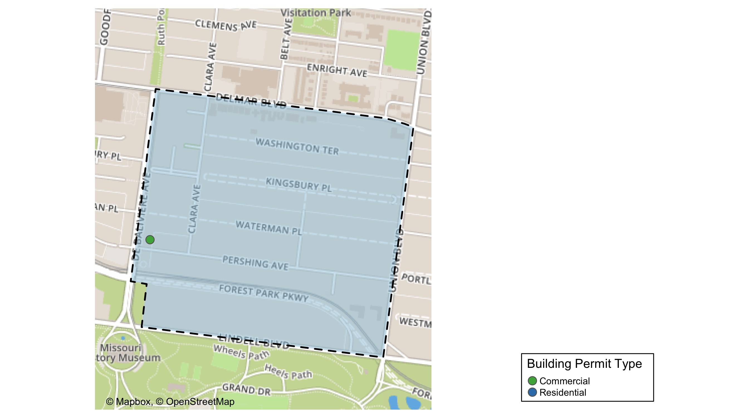
DeBaliviere Place

Slide 27
Neighborhood Summary
October 2021 | October 2021 | October 2021 | October 2021
Permit Use | Average Cost | # of Permits | Total Value of Permits
Commercial | $2,500 | 1 | $2,500
Industrial | $0 | 0 | $0
Residential | $42,000 | 1 | $42,000
Last 6 Months | Last 6 Months | Last 6 Months | Last 6 Months
Permit Use | Average Cost | # of Permits | Total Value of Permits
Commercial | $40,816 | 6 | $244,896
Industrial | $63,500 | 1 | $63,500
Residential | $90,508 | 23 | $2,081,684

Slide 28
DeBaliviere Place Individual Permit Breakdown
nbhd_name | Owner | New Use | Cost | address
DeBaliviere Place | GRAY, TIMOTHY JOHN & DIANNE ALISON T | Residential | $42,000 | 41 KINGSBURY PL
DeBaliviere Place | BONDS, GWENDOLYN | Commercial | $2,500 | 5316 PERSHING AV

Slide 29
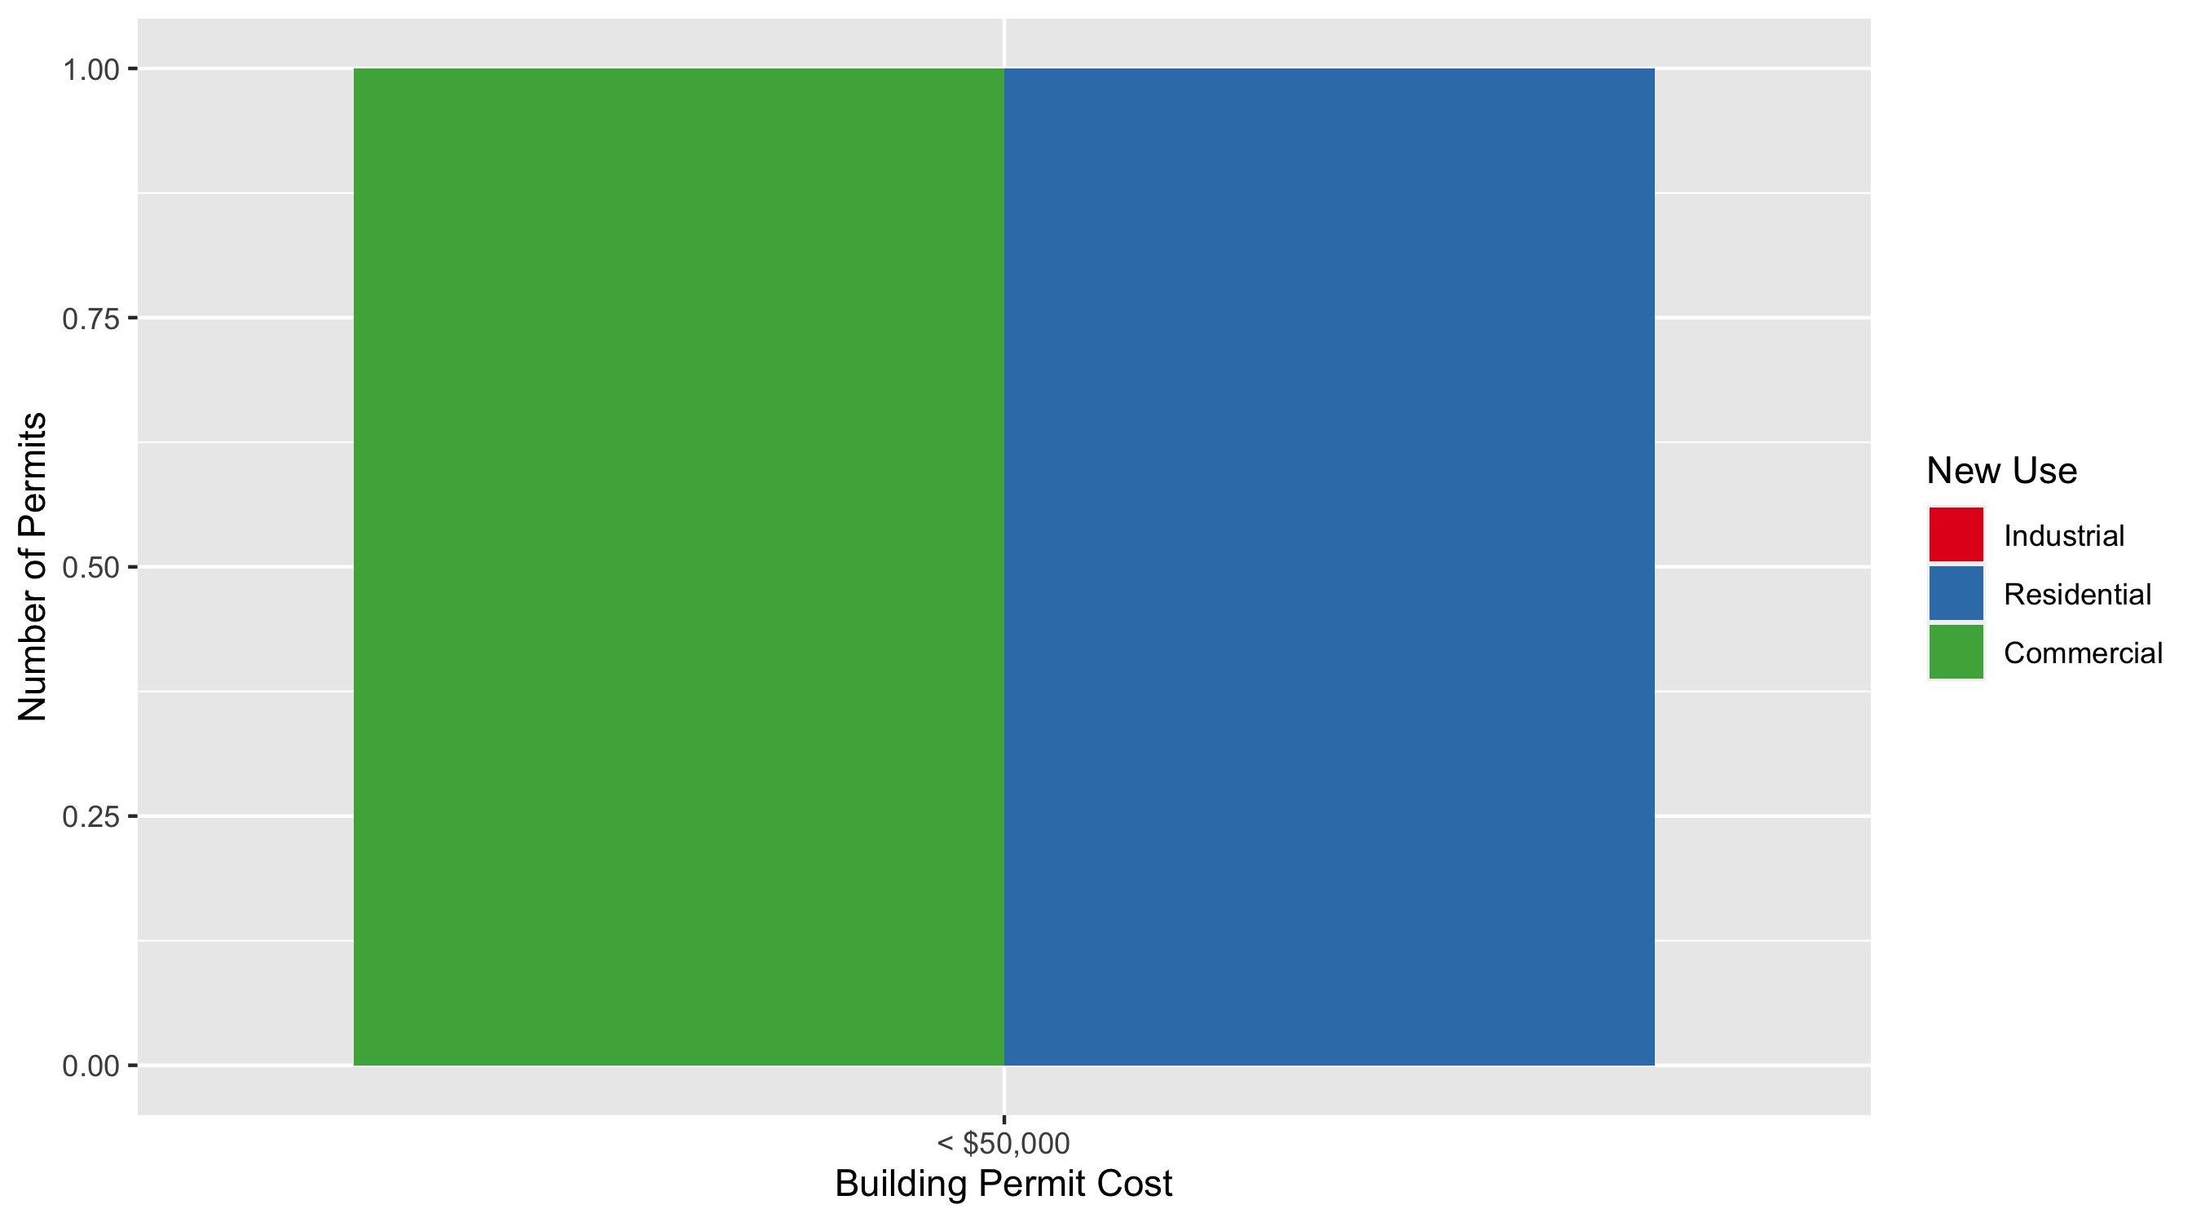
DeBaliviere Place Permit Cost Breakdown

Slide 30
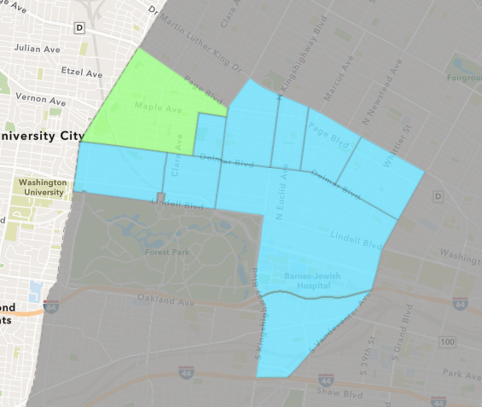
West End
October 2021 Neighborhood Cost Breakdown
Mean: $25,200
Median: $6,267
Range: $3,000 - $225,000

Slide 31
West End: Summary Notes
12 building permits in October 2021
50.00% change compared to October 2020 (8 total building permits)
$25,200: Average building permit cost in October 2021
-26.42% change compared to October 2020 ($34,247)
128 total building permits in 2021
82.86% change YTD compared to this time in 2020 (70 total building permits)
$74,551: YTD average building permit cost in 2021
-71.53% change YTD compared to this time in 2020 ($261,866)

Slide 32
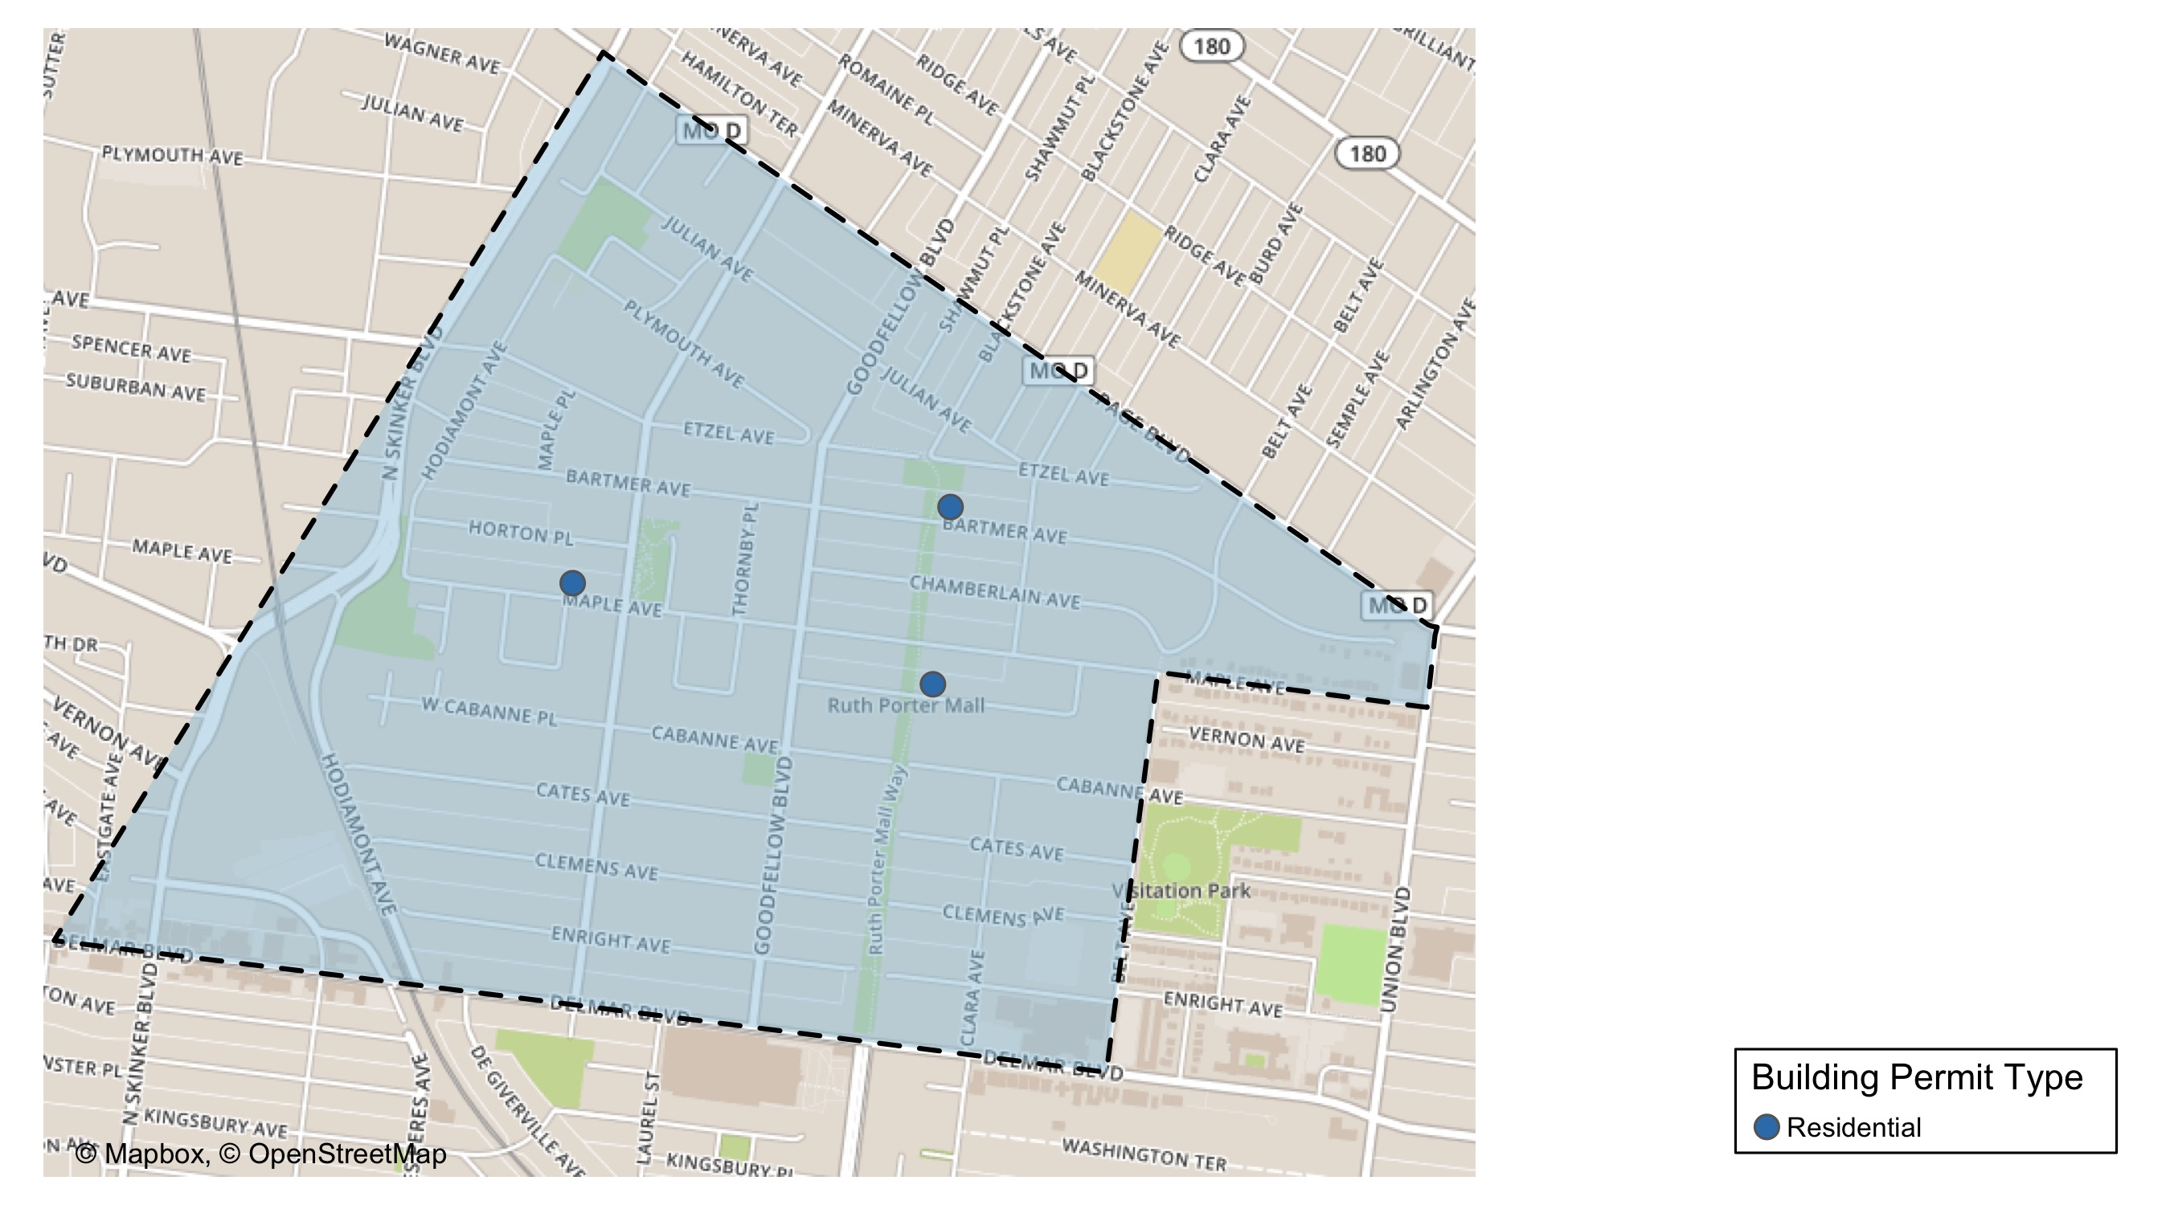
West End

Slide 33
Neighborhood Summary
October 2021 | October 2021 | October 2021 | October 2021
Permit Use | Average Cost | # of Permits | Total Value of Permits
Commercial | $31,578.333 | 9 | $284,205
Industrial | $0.000 | 0 | $0
Residential | $6,064.333 | 3 | $18,193
Last 6 Months | Last 6 Months | Last 6 Months | Last 6 Months
Permit Use | Average Cost | # of Permits | Total Value of Permits
Commercial | $45,856.75 | 48 | $2,201,124
Industrial | $25,115.25 | 4 | $100,461
Residential | $88,727.34 | 53 | $4,702,549

Slide 34
West End Individual Permit Breakdown
nbhd_name | Owner | New Use | Cost | address
West End | YOUNG, TRAVIS S | Residential | $3,000 | 5617 VERNON AV
West End | DELMAR DIVINE CONDO | Commercial | $225,000 | 5501 DELMAR BLVD
West End | DELMAR DIVINE MASTER LANDLORD | Commercial | $6,913 | 5535 DELMAR BLVD
West End | DELMAR DIVINE MASTER LANDLORD | Commercial | $12,115 | 5535 DELMAR BLVD
West End | DELMAR DIVINE CONDO | Commercial | $14,490 | 5535 DELMAR BLVD
West End | DELMAR DIVINE CONDO | Commercial | $4,884 | 5535 DELMAR BLVD
West End | DELMAR DIVINE CONDO | Commercial | $7,004 | 5535 DELMAR BLVD
West End | DELMAR DIVINE CONDO | Commercial | $5,621 | 5535 DELMAR BLVD
West End | DELMAR DIVINE CONDO | Commercial | $4,213 | 5535 DELMAR BLVD
West End | DELMAR DIVINE CONDO | Commercial | $3,965 | 5535 DELMAR BLVD
West End | FIELDS, TERRELL ROBERT SR & | Residential | $12,000 | 6004 HORTON PL
West End | STROTHER, BEVERLY A & EARLEAN STROTH | Residential | $3,193 | 5720 ETZEL AV

Slide 35
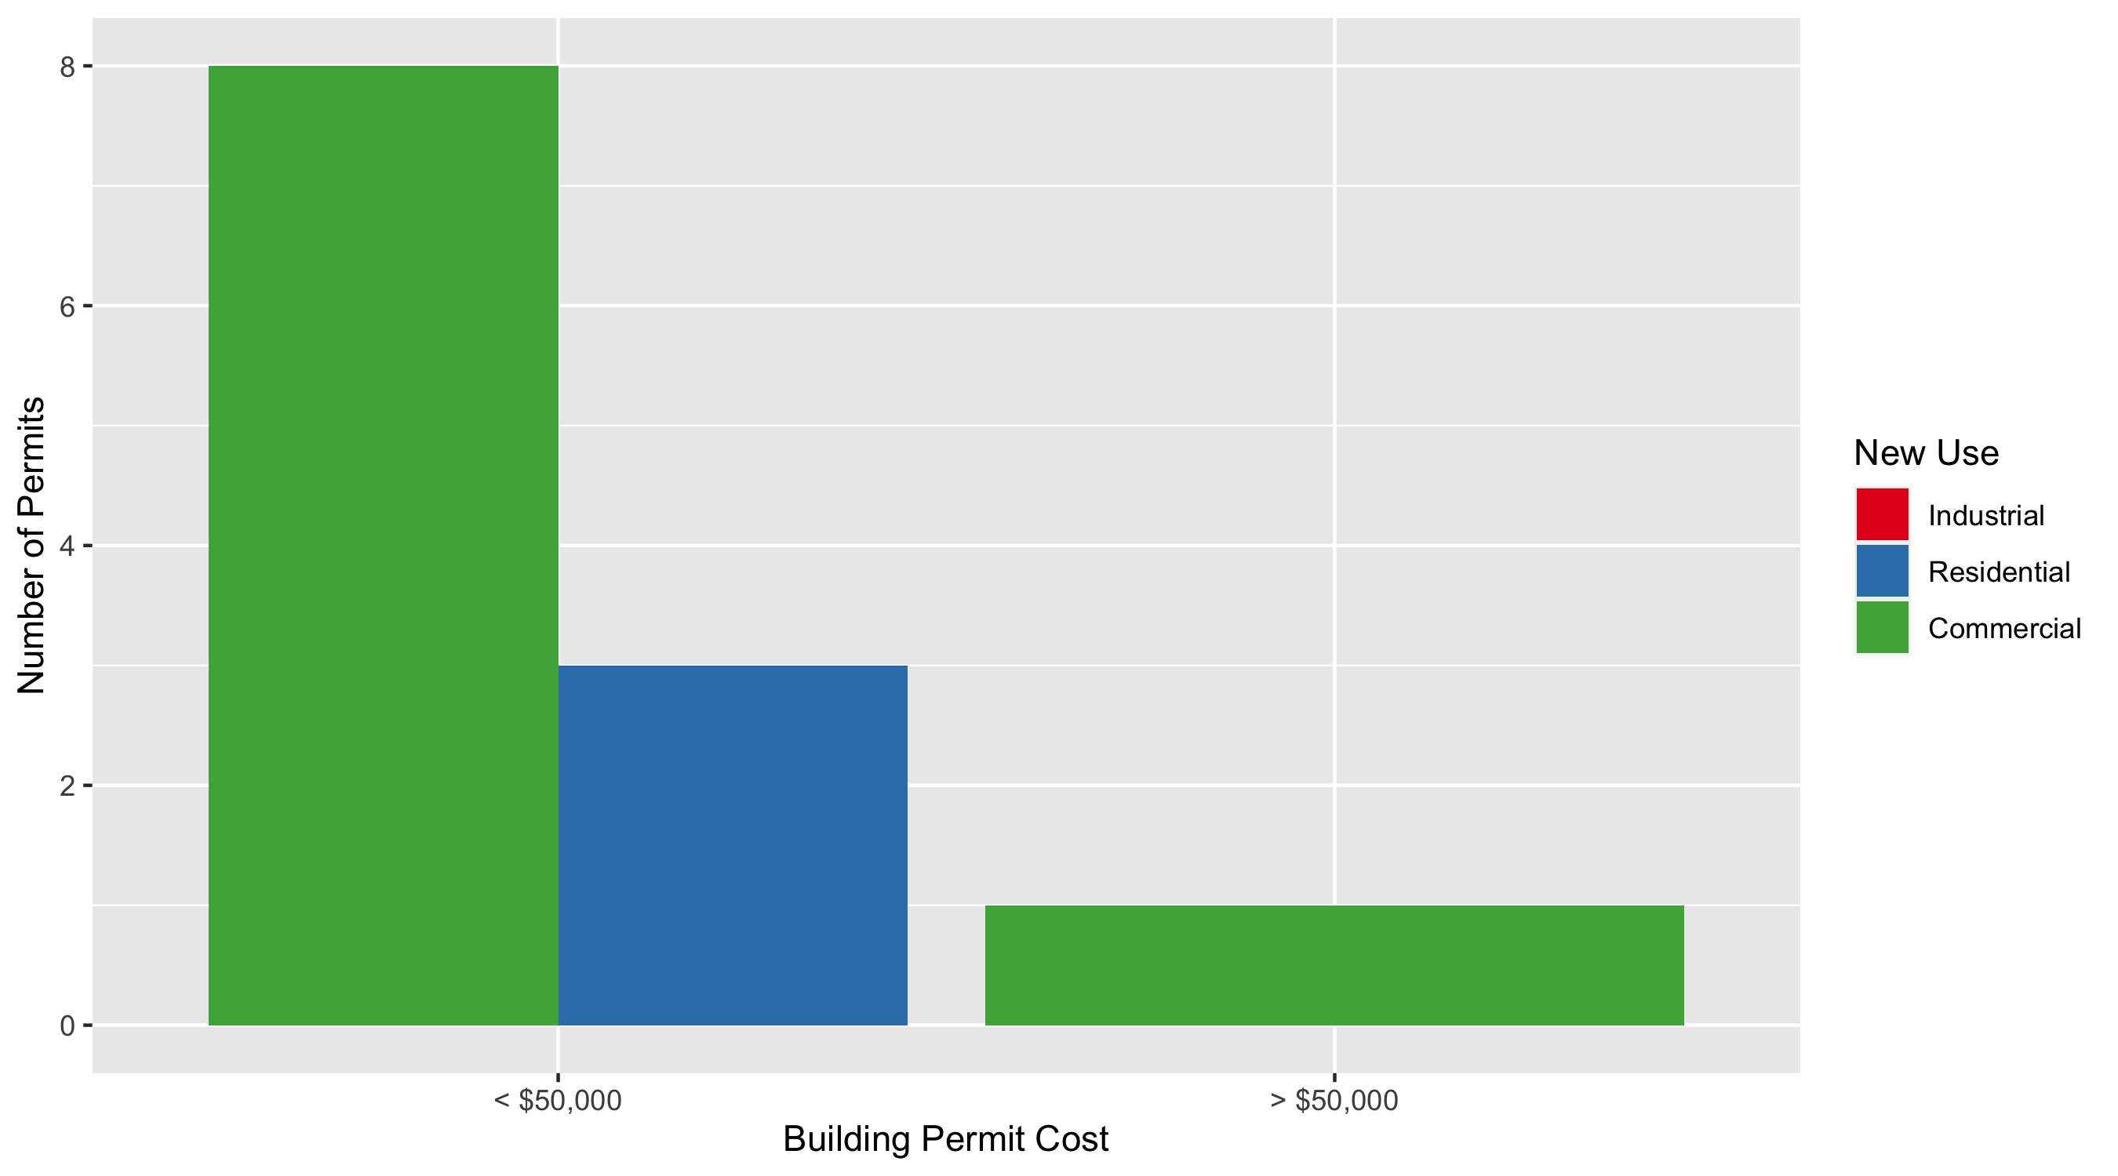
West End Permit Cost Breakdown

Slide 36
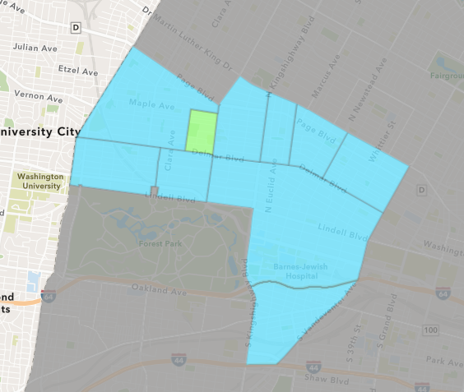
Visitation Park
October 2021 Neighborhood Cost Breakdown
Mean: $4,000
Median: $4,000
Range: $4,000 - $4,000

Slide 37
Visitation Park: Summary Notes
1 building permits in October 2021
Infinite change compared to October 2020 (0 total building permits)
$4,000: Average building permit cost in October 2021
Infinite change compared to October 2020 ($0)
2 total building permits in 2021
-66.67% change YTD compared to this time in 2020 (6 total building permits)
$2,450: YTD average building permit cost in 2021
-86.57% change YTD compared to this time in 2020 ($18,242)

Slide 38
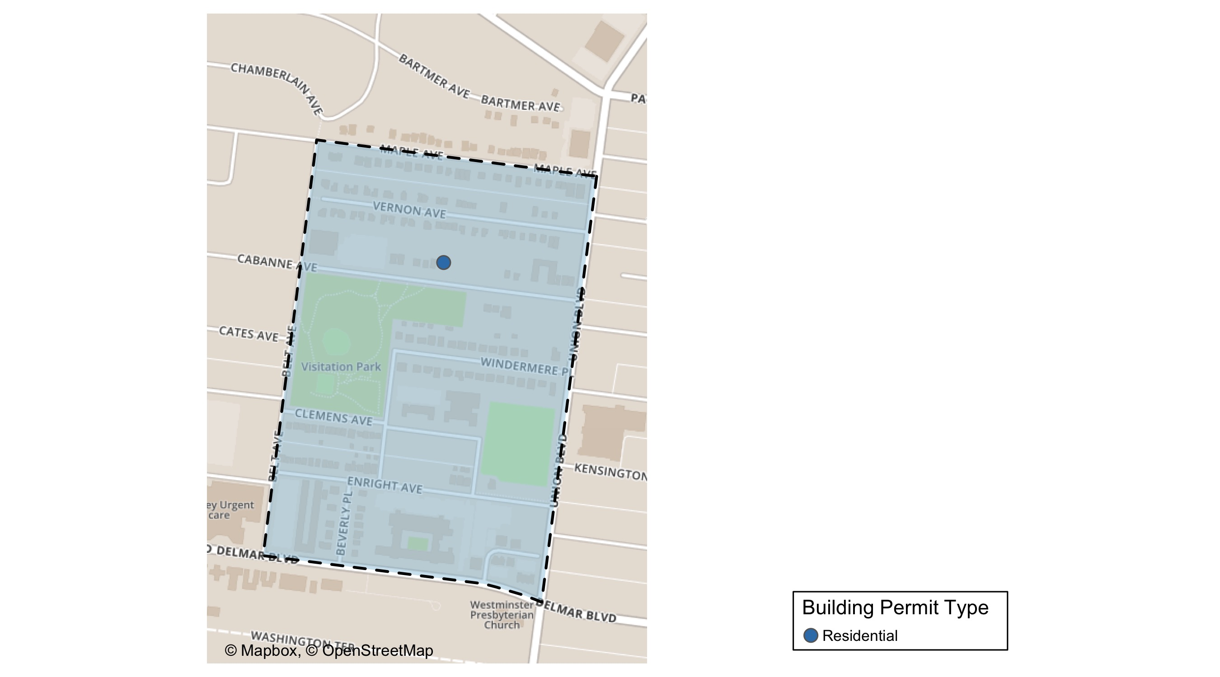
Visitation Park

Slide 39
Neighborhood Summary
October 2021 | October 2021 | October 2021 | October 2021
Permit Use | Average Cost | # of Permits | Total Value of Permits
Commercial | $0 | 0 | $0
Industrial | $0 | 0 | $0
Residential | $4,000 | 1 | $4,000
Last 6 Months | Last 6 Months | Last 6 Months | Last 6 Months
Permit Use | Average Cost | # of Permits | Total Value of Permits
Commercial | $0 | 0 | $0
Industrial | $0 | 0 | $0
Residential | $2,450 | 2 | $4,900

Slide 40
Visitation Park Individual Permit Breakdown
nbhd_name | Owner | New Use | Cost | address
Visitation Park | EVERETT, EDGAR III & | Residential | $4,000 | 1 WINDERMERE PL

Slide 41
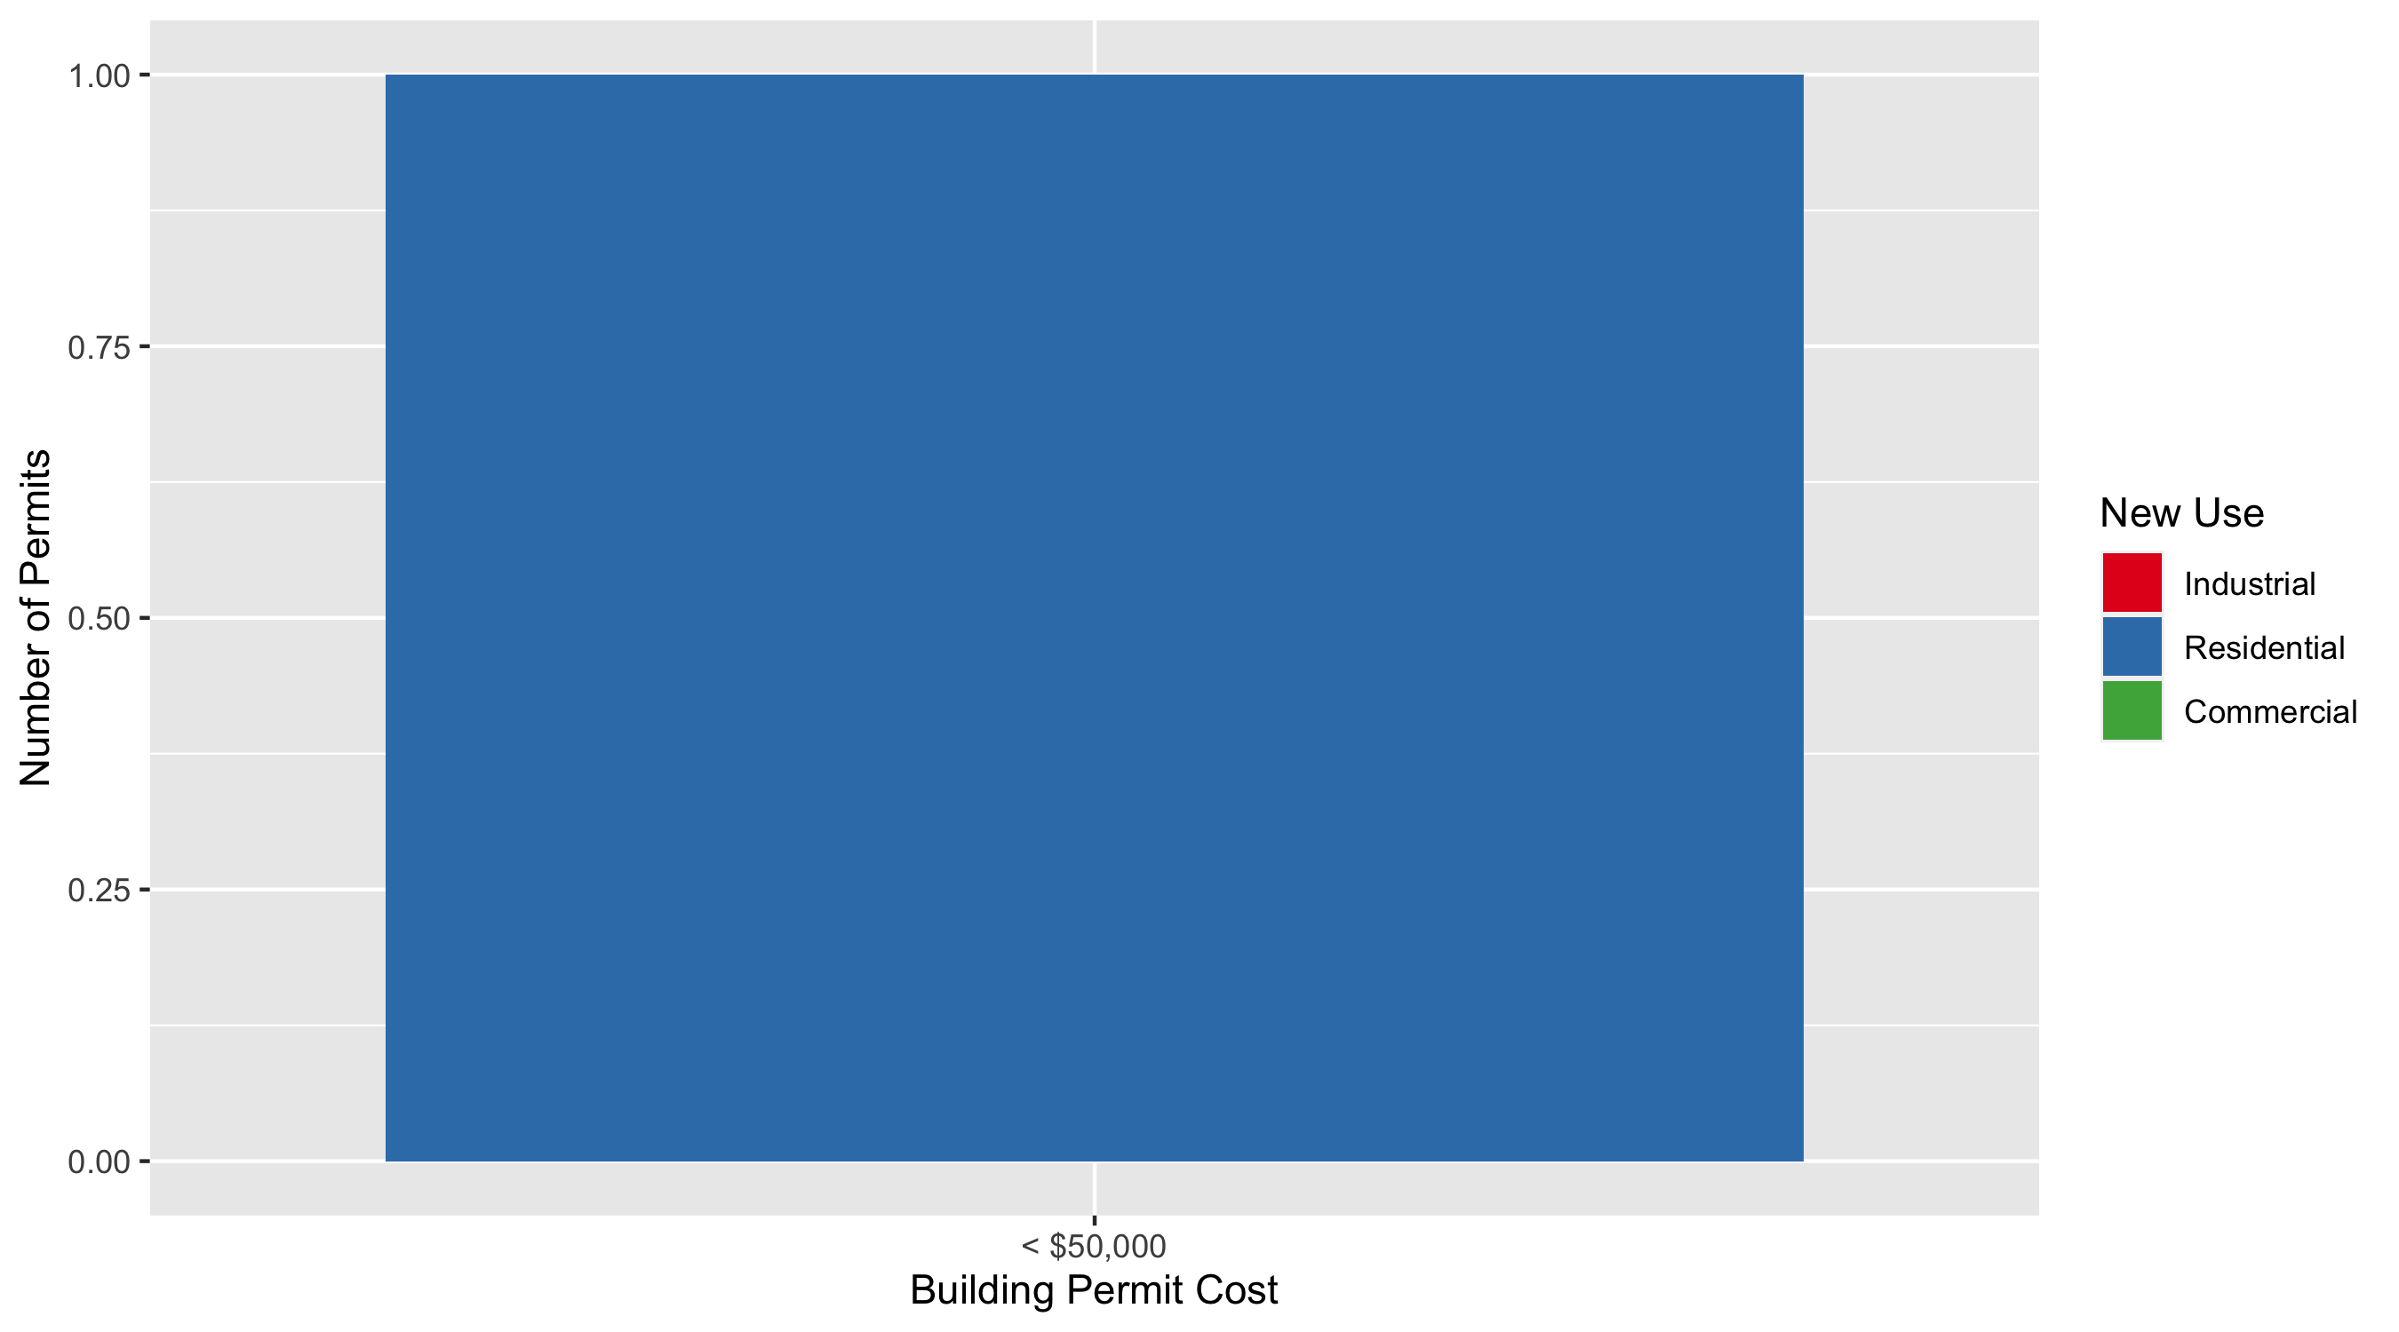
Visitation Park Permit Cost Breakdown

Slide 42
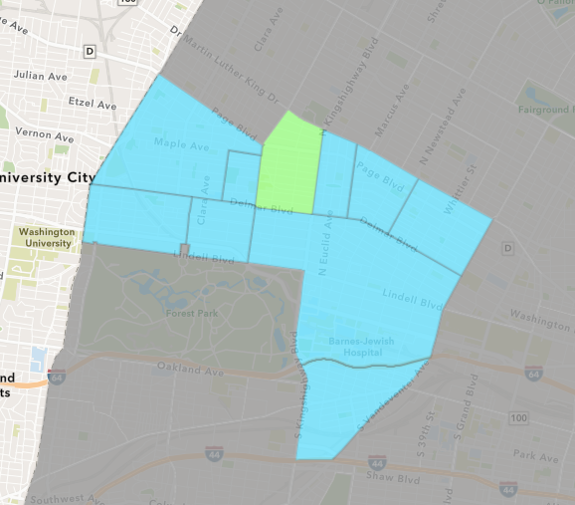
Academy
October 2021 Neighborhood Cost Breakdown
Mean: $117,125
Median: $8,000
Range: $2,500 - $450,000

Slide 43
Academy: Summary Notes
4 building permits in October 2021
33.33% change compared to October 2020 (3 total building permits)
$117,125: Average building permit cost in October 2021
4243.33% change compared to October 2020 ($2,697)
30 total building permits in 2021
7.14% change YTD compared to this time in 2020 (28 total building permits)
$46,740: YTD average building permit cost in 2021
-2.56% change YTD compared to this time in 2020 ($47,970)

Slide 44
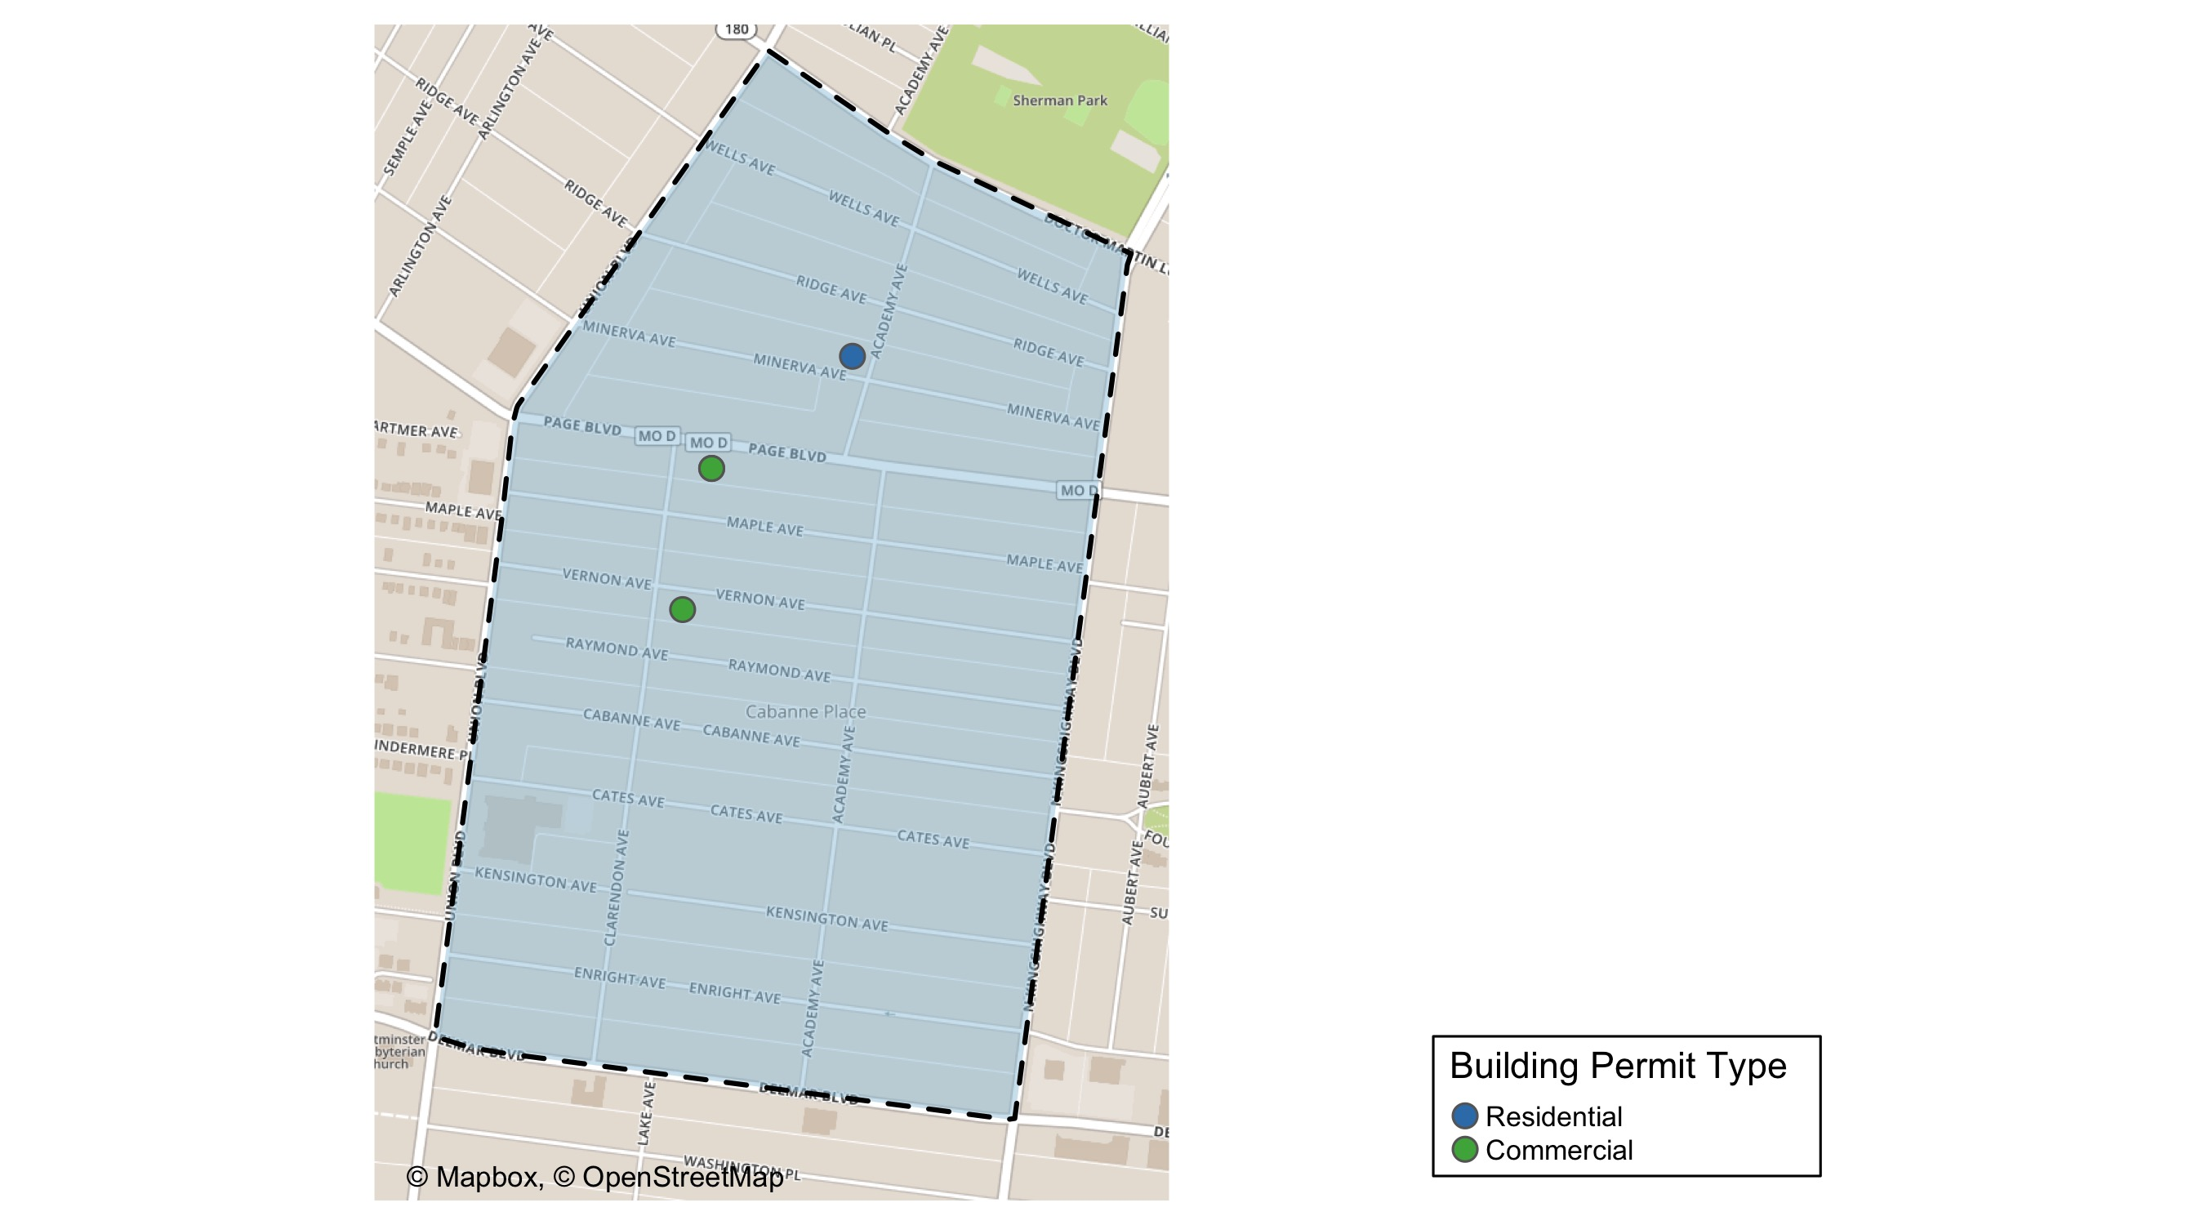
Academy

Slide 45
Neighborhood Summary
October 2021 | October 2021 | October 2021 | October 2021
Permit Use | Average Cost | # of Permits | Total Value of Permits
Commercial | $155,266.7 | 3 | $465,800
Industrial | $0.0 | 0 | $0
Residential | $2,700.0 | 1 | $2,700
Last 6 Months | Last 6 Months | Last 6 Months | Last 6 Months
Permit Use | Average Cost | # of Permits | Total Value of Permits
Commercial | $117,575.00 | 4 | $470,300
Industrial | $575.00 | 4 | $2,300
Residential | $41,789.12 | 17 | $710,415

Slide 46
Academy Individual Permit Breakdown
nbhd_name | Owner | New Use | Cost | address
Academy | YOUTH IN NEED | Commercial | $450,000 | 5183 RAYMOND AV
Academy | KARAM INC | Commercial | $2,500 | 1148 UNION BLVD
Academy | YOUTH IN NEED | Commercial | $13,300 | 5183 RAYMOND AV
Academy | FEDERAL NATIONAL MORTGAGE ASSOC | Residential | $2,700 | 5230 RIDGE AV

Slide 47
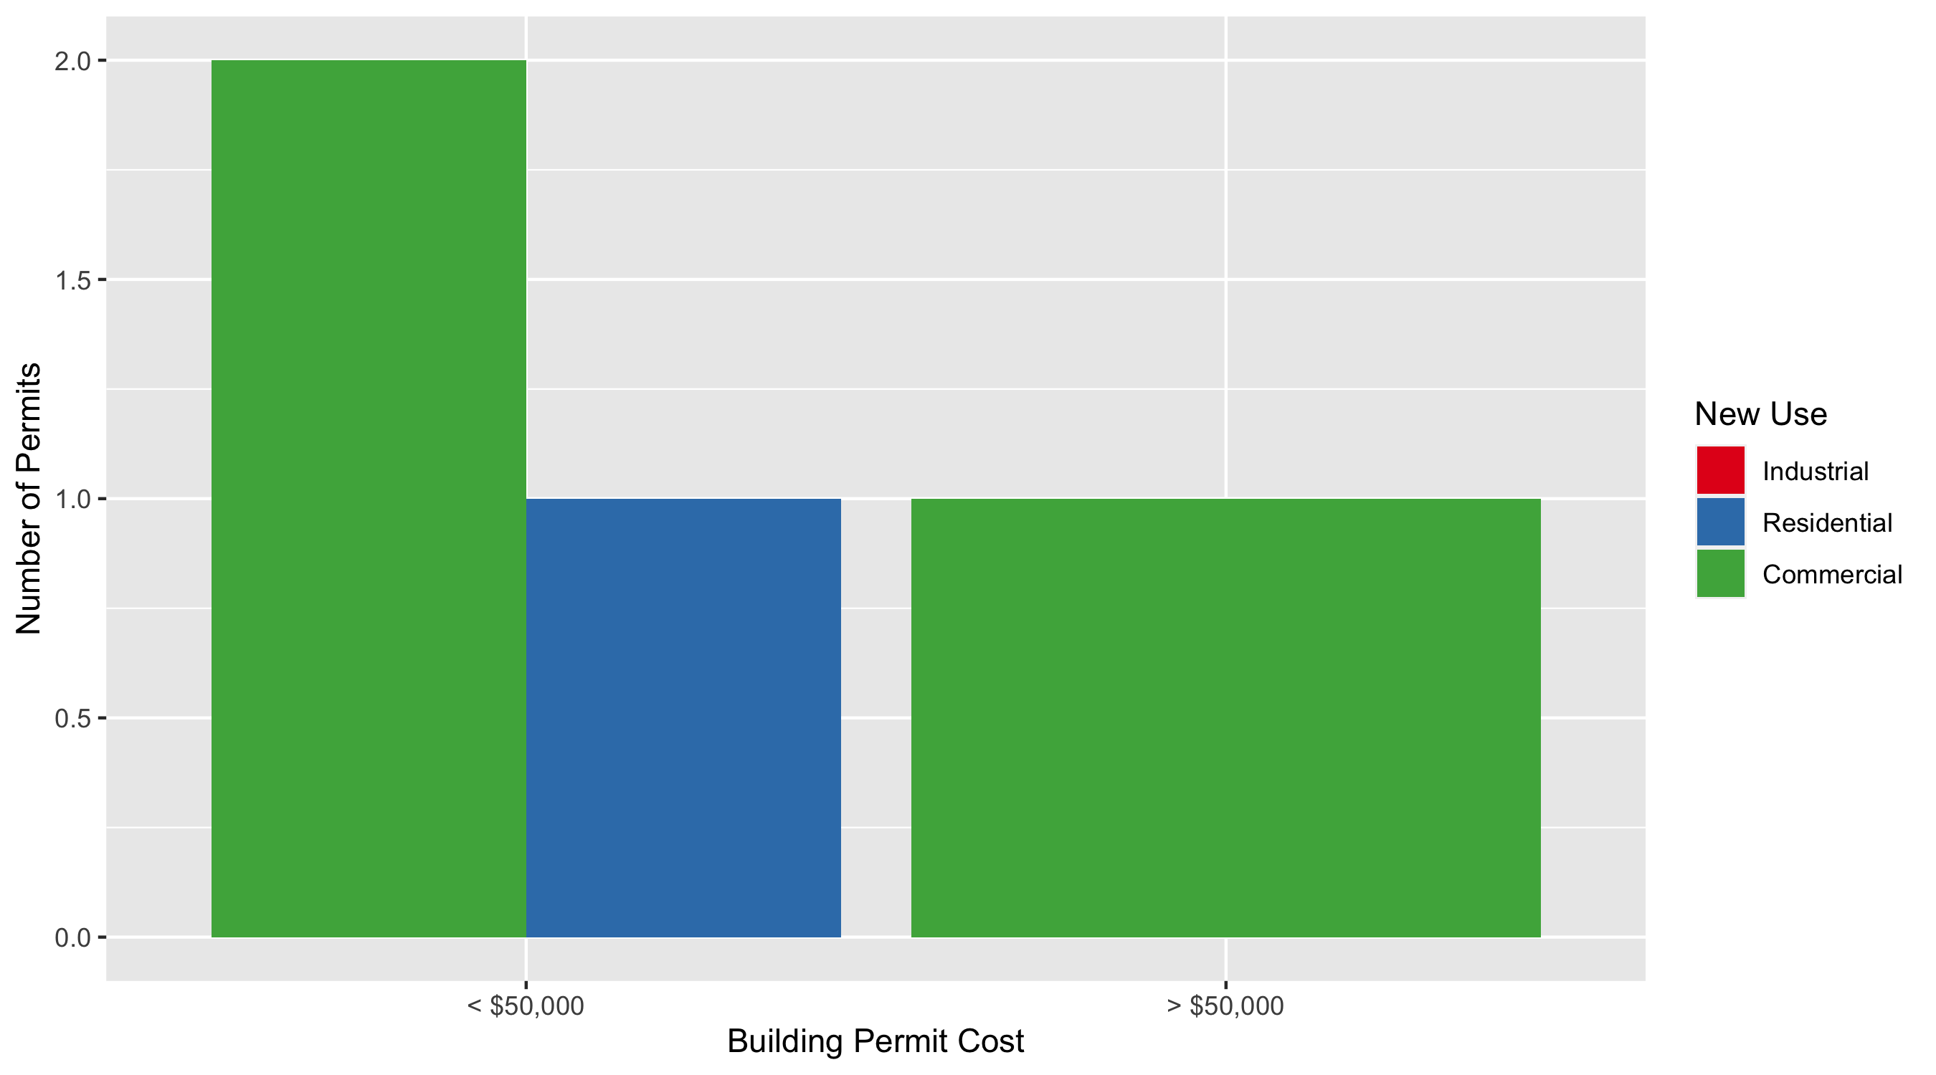
Academy Permit Cost Breakdown

Slide 48
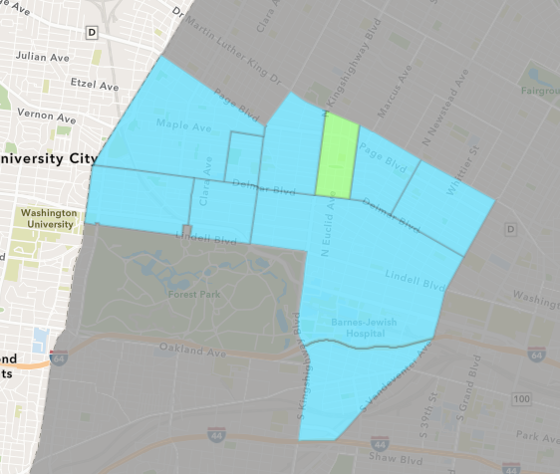
Fountain Park
October 2021 Neighborhood Cost Breakdown
Mean: $47,000
Median: $36,500
Range: $15,000 - $100,000

Slide 49
Fountain Park: Summary Notes
4 building permits in October 2021
300.00% change compared to October 2020 (1 total building permits)
$47,000: Average building permit cost in October 2021
-73.14% change compared to October 2020 ($175,000)
19 total building permits in 2021
280.00% change YTD compared to this time in 2020 (5 total building permits)
$354,050: YTD average building permit cost in 2021
791.81% change YTD compared to this time in 2020 ($39,700)

Slide 50
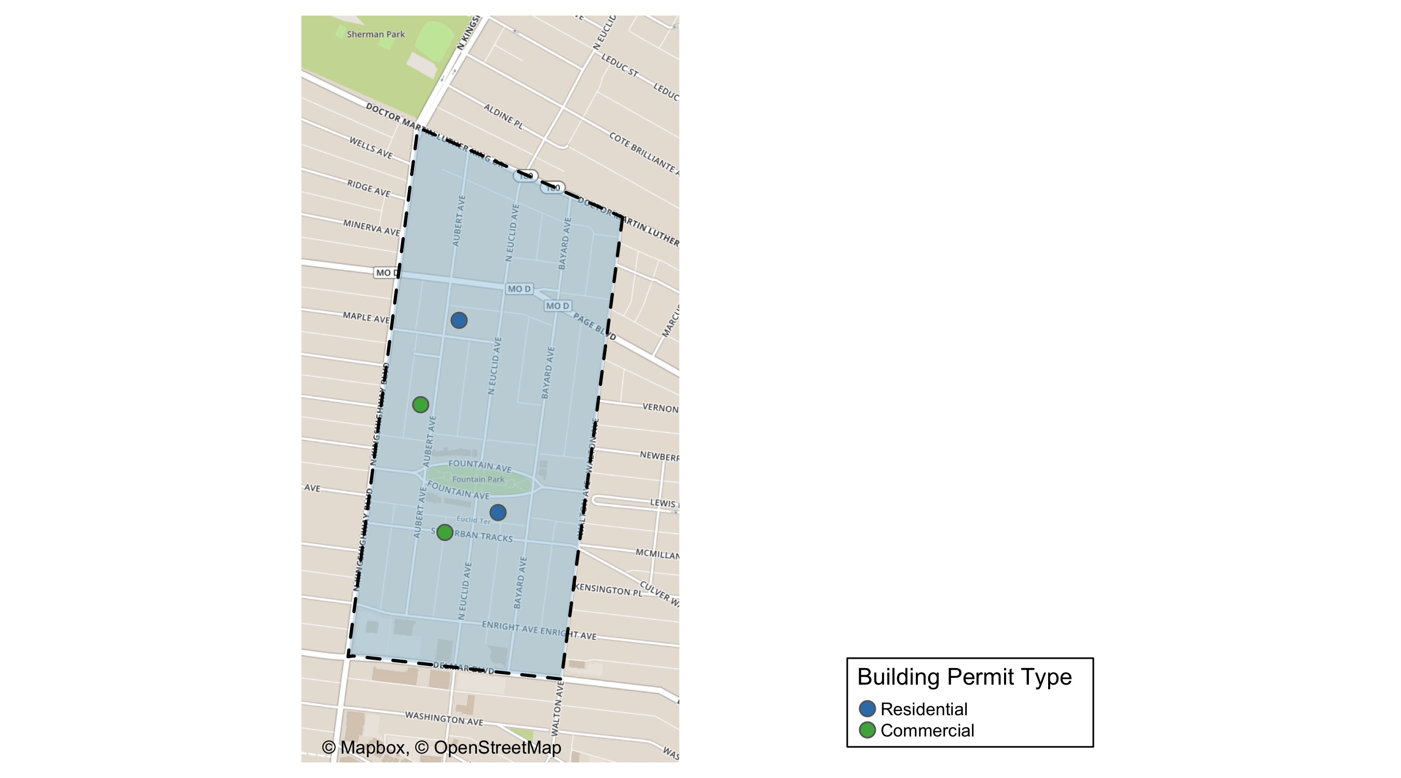
Fountain Park

Slide 51
Neighborhood Summary
October 2021 | October 2021 | October 2021 | October 2021
Permit Use | Average Cost | # of Permits | Total Value of Permits
Commercial | $36,500 | 2 | $73,000
Industrial | $0 | 0 | $0
Residential | $57,500 | 2 | $115,000
Last 6 Months | Last 6 Months | Last 6 Months | Last 6 Months
Permit Use | Average Cost | # of Permits | Total Value of Permits
Commercial | $607,902.67 | 6 | $3,647,416
Industrial | $25,000.00 | 1 | $25,000
Residential | $29,955.71 | 7 | $209,690

Slide 52
Fountain Park Individual Permit Breakdown
nbhd_name | Owner | New Use | Cost | address
Fountain Park | KINGSWAY DEVELOPMENT LLC | Residential | $100,000 | 736 N EUCLID AV
Fountain Park | LAUNCHCODE 4811 DELMAR BUILDING OWNE | Commercial | $45,000 | 4811 DELMAR BLVD
Fountain Park | ALDI INC | Commercial | $28,000 | 702 N KINGSHIGHWAY BLVD
Fountain Park | BOURN, DOMINIQUE | Residential | $15,000 | 4969 FOUNTAIN AV

Slide 53
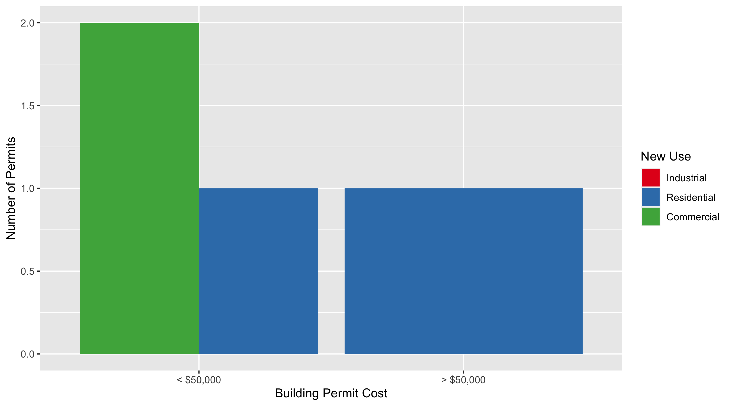
Fountain Park Permit Cost Breakdown

Slide 54
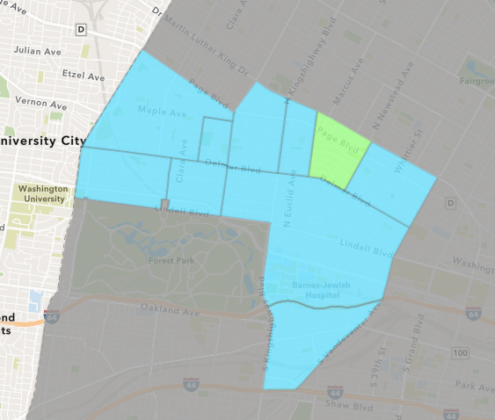
Lewis Place
October 2021 Neighborhood Cost Breakdown
Mean: $24,167
Median: $6,500
Range: $2,000 - $80,000

Slide 55
Lewis Place: Summary Notes
6 building permits in October 2021
100.00% change compared to October 2020 (3 total building permits)
$24,167: Average building permit cost in October 2021
-57.97% change compared to October 2020 ($57,500)
20 total building permits in 2021
100.00% change YTD compared to this time in 2020 (10 total building permits)
$71,220: YTD average building permit cost in 2021
104.09% change YTD compared to this time in 2020 ($34,896)

Slide 56
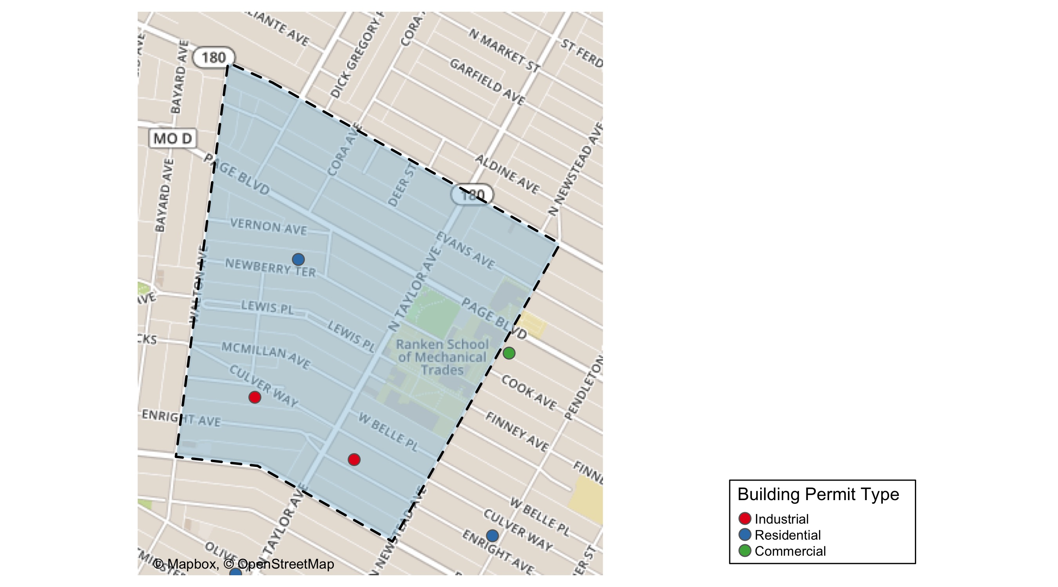
Lewis Place

Slide 57
Neighborhood Summary
October 2021 | October 2021 | October 2021 | October 2021
Permit Use | Average Cost | # of Permits | Total Value of Permits
Commercial | $7,000.00 | 1 | $7,000
Industrial | $2,000.00 | 2 | $4,000
Residential | $44,666.67 | 3 | $134,000
Last 6 Months | Last 6 Months | Last 6 Months | Last 6 Months
Permit Use | Average Cost | # of Permits | Total Value of Permits
Commercial | $279,084.00 | 4 | $1,116,336
Industrial | $20,000.00 | 3 | $60,000
Residential | $20,904.78 | 9 | $188,143

Slide 58
Lewis Place Individual Permit Breakdown
nbhd_name | Owner | New Use | Cost | address
Lewis Place | RANKEN TECHNICAL COLLEGE | Commercial | $7,000 | 4443 COOK AV
Lewis Place | OCG CAPITAL LLC | Residential | $80,000 | 4439 ENRIGHT AV
Lewis Place | HOPEWELL MISS BAP CH | Industrial | $2,000 | 4486 WEST BELLE PL
Lewis Place | HOPEWELL M B C | Industrial | $2,000 | 4589 KENSINGTON AV
Lewis Place | K AND K REAL ESTATE DEV | Residential | $6,000 | 4714 VERNON AV
Lewis Place | DMS FINANCIAL LLC | Residential | $48,000 | 4473 DELMAR BLVD

Slide 59
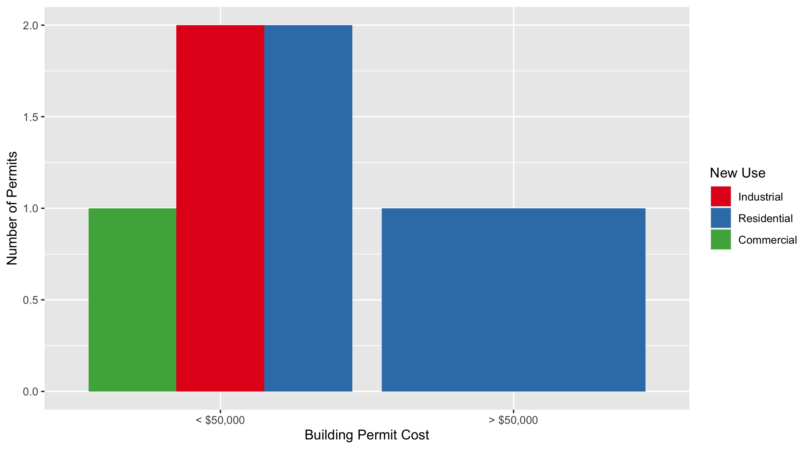
Lewis Place Permit Cost Breakdown

Slide 60
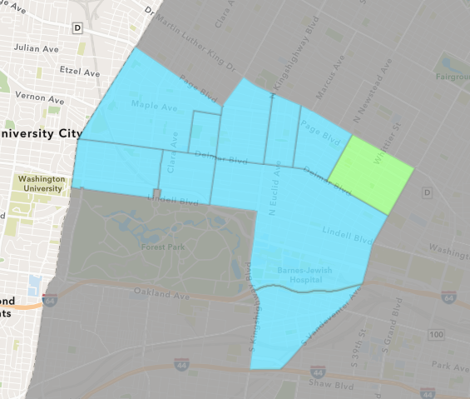
Vandeventer
October 2021 Neighborhood Cost Breakdown
Mean: $37,442
Median: $11,326
Range: $1,000 - $100,000

Slide 61
Vandeventer: Summary Notes
3 building permits in October 2021
50.00% change compared to October 2020 (2 total building permits)
$37,442: Average building permit cost in October 2021
301.54% change compared to October 2020 ($9,324)
14 total building permits in 2021
27.27% change YTD compared to this time in 2020 (11 total building permits)
$97,188: YTD average building permit cost in 2021
94.12% change YTD compared to this time in 2020 ($50,066)

Slide 62
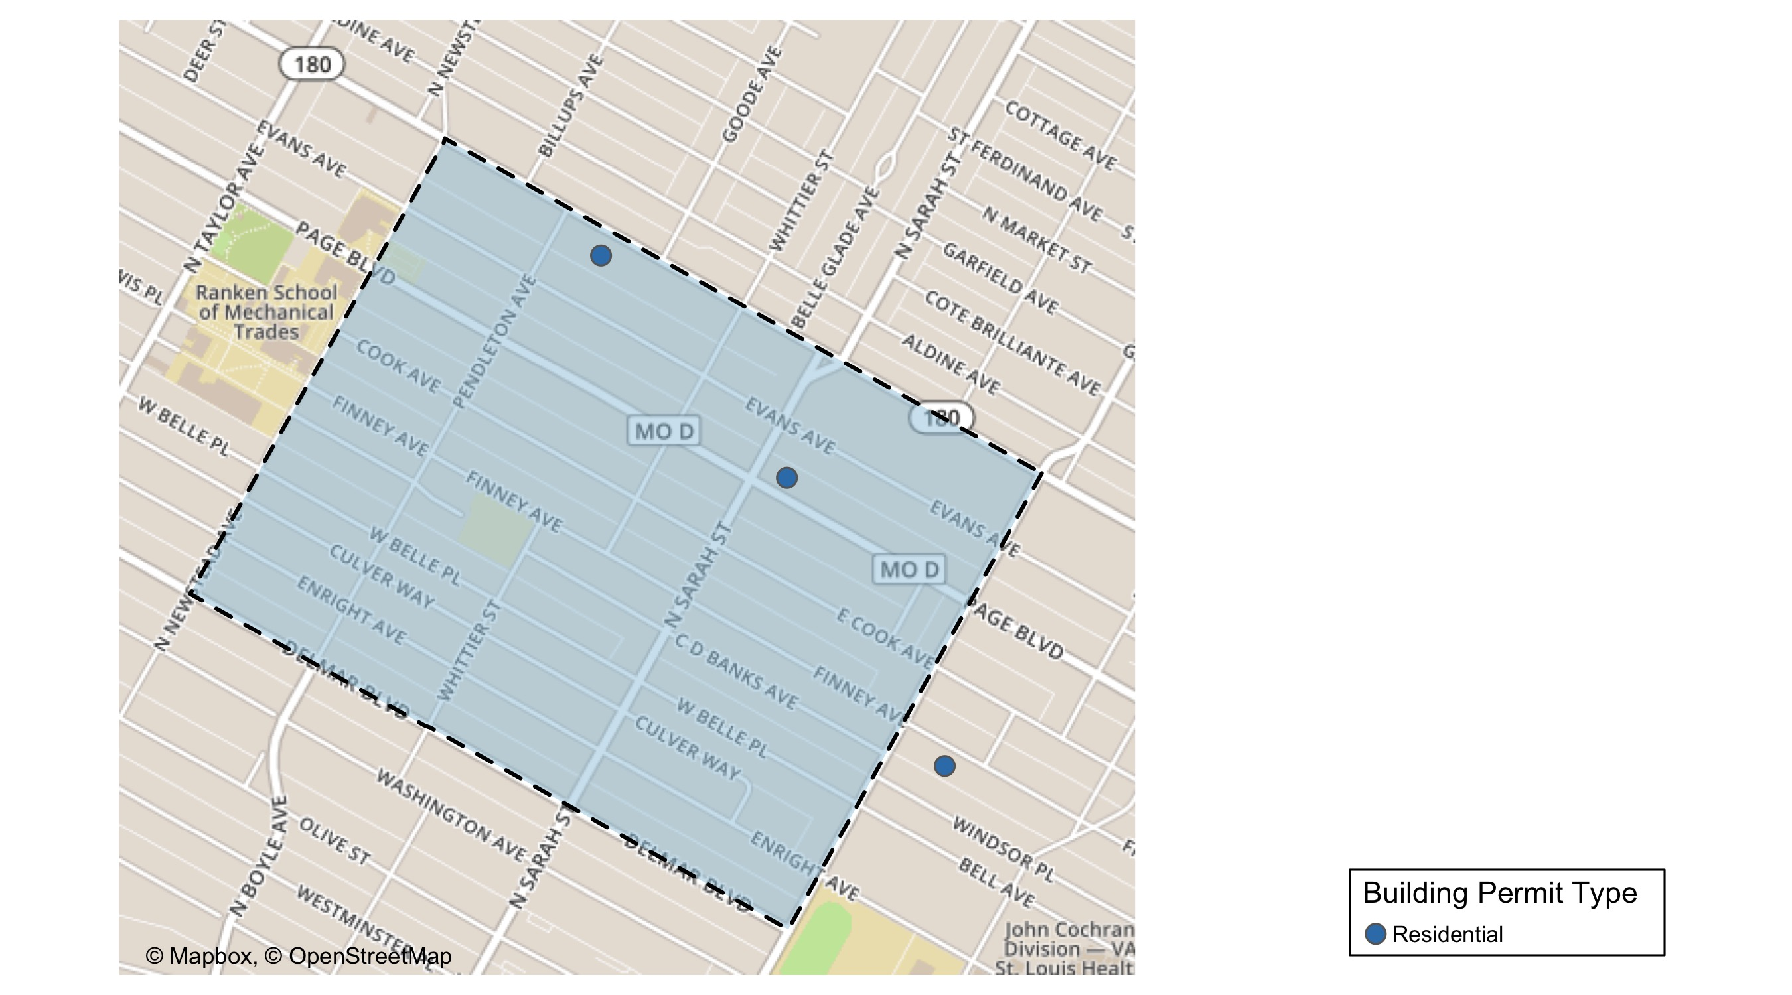
Vandeventer

Slide 63
Neighborhood Summary
October 2021 | October 2021 | October 2021 | October 2021
Permit Use | Average Cost | # of Permits | Total Value of Permits
Commercial | $0 | 0 | $0
Industrial | $0 | 0 | $0
Residential | $37,442 | 3 | $112,326
Last 6 Months | Last 6 Months | Last 6 Months | Last 6 Months
Permit Use | Average Cost | # of Permits | Total Value of Permits
Commercial | $0.0 | 0 | $0
Industrial | $3,650.0 | 2 | $7,300
Residential | $112,777.2 | 12 | $1,353,326

Slide 64
Vandeventer Individual Permit Breakdown
nbhd_name | Owner | New Use | Cost | address
Vandeventer | HAYES, KERRY & DEBRA A | Residential | $11,326 | 3971 PAGE BLVD
Vandeventer | GULLIEHAN, KEVIN | Residential | $100,000 | 4369 EVANS AV
Vandeventer | NEAL, YOLANDA | Residential | $1,000 | 4219 W FINNEY AV

Slide 65
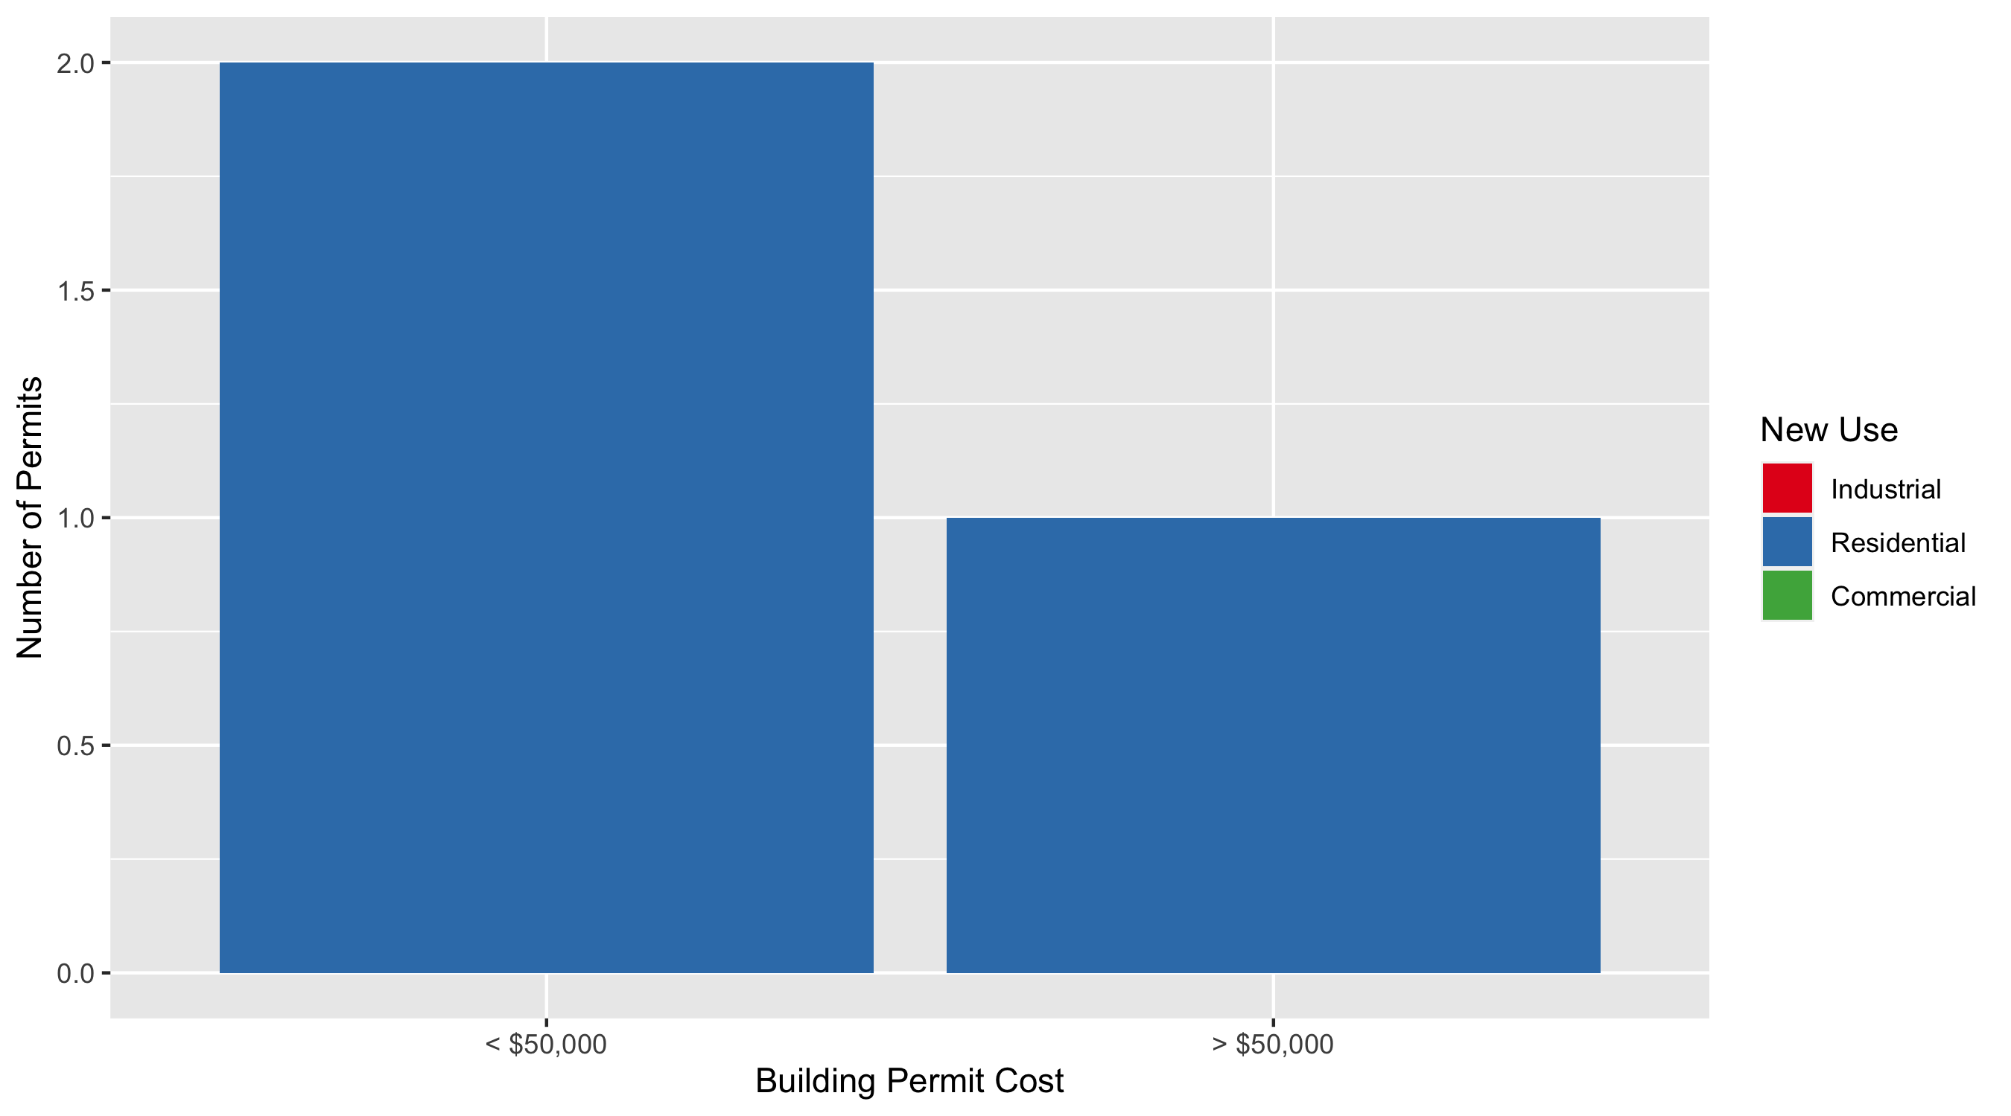
Vandeventer Permit Cost Breakdown

Slide 66
Additional Notes
Data retreived from https://www.stlouis-mo.gov/data/
Building permits with a cost of $0 were dropped
Building permits that were cancelled were dropped
Infinite change indicates 0 permits in the current or previous time period/comparison month so there was a overall increase or decrease

